Slide 1
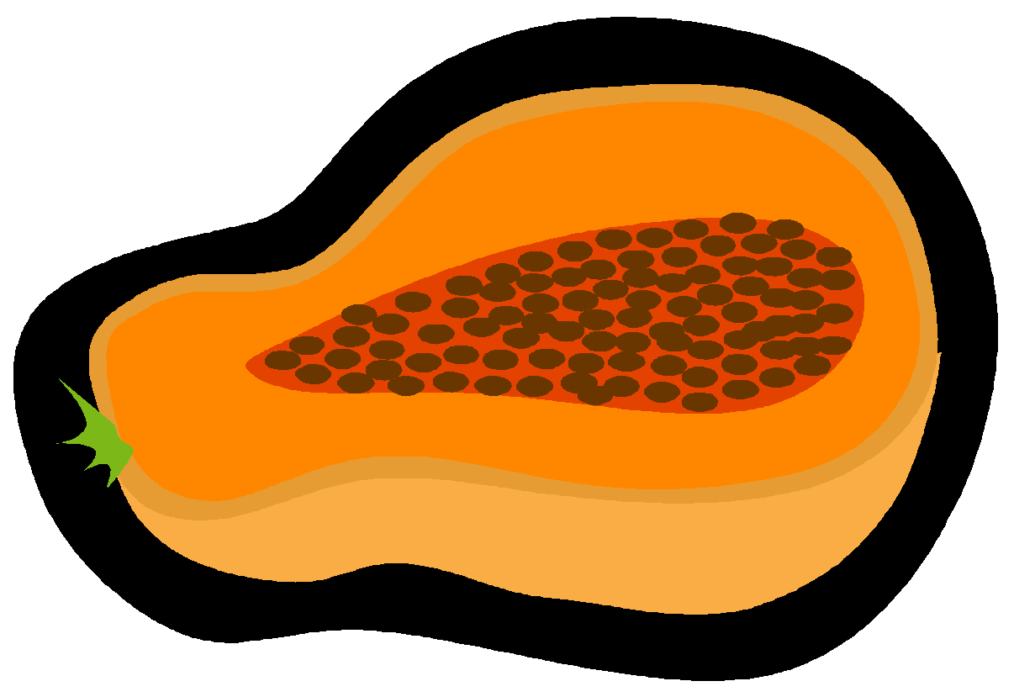
Uterine Aspiration:
Workshop
University of Washington
Dept of Family Medicine

Slide 2
4/7/25: Disclaimer:
Hi all - thank you so much for coming to this workshop. These slides have some links for you to explore. Please reach out anytime with questions!
As you review the slides please keep in mind that this care is for all people– - I imagine many of you have had lectures on gynecology before that used incredibly gendered language (for example the video at the end of this talk). Sometimes speakers will acknowledge the importance of gender diversity but then proceed to only talk about “women”.
I encourage you all if you haven't already to practice used more gender inclusive language in your clinical care, with your friends and family and in your own teaching. Think about how we can make our clinical spaces feel safer for everyone in our communities.
I also encourage you all to provide feedback to your trainers, professors, attendings because this is how we grow. And If anyone has feedback for me on how to make this presentation more inclusive, accurate, or helpful – please reach out to me or submit anonymously.

Slide 3
Disclosures & Acknowledgements
I acknowledge that I traveled through and am on the Indigenous Land of the Coast Salish peoples. I thank these caretakers of this land who have lived and continue to live here since time immemorial.
2

Slide 4

Thinking About Our Language:

Slide 5

Why are we here?

Slide 6

Notes:
Updated most to least restrictive

Slide 7

Session
Roadmap
Overview of manual uterine aspiration steps
Papaya model & tray set-up
Video
Hands-on practice

Slide 8
Uterine Aspiration
What are some indications?
What are some contraindications?
Notes:
Indications:
Miscarriage management
Pregnancy termination
Evaluation of ectopic pregnancy
IUD removal
Contraindications:
Anatomy restricting access to uterine cavity
Relative – bleeding disorder, severe anemia, unstable CV or respiratory status

Slide 9
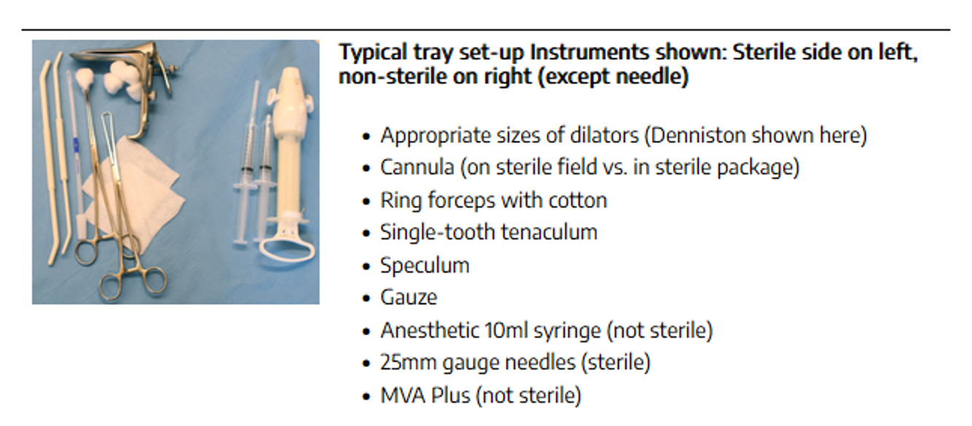

Slide 10
Uterine Aspiration: Major Steps
Pre-procedure Consent
Bimanual Exam
Visualization of Cervix
Paracervical Lidocaine Block
Cervical Dilation, if needed
Aspiration
Tissue evaluation

Slide 11
Pre-procedure prep
Pre-procedure
  Estimate gestational age: LMP +/- US
  Labs? Maybe: Hgb/HCT; Rh status based on GA
    Offer gonorrhea/ chlamydia, not required
  Pain Management: NSAID 30-60 min pre-procedure
  Antibiotics: Doxy 200mg PO prior to procedure
    OR Metronidazole 1g PO; Azithromycin 500mg PO
  Anxiolytic: Lorazepam 0.5-2mg SL 30min prior
    Moderate procedural sedation also an option
Notes:
Ultrasound is done preabortion in most high volume clinics to confirm dates and intrauterine pregnancy.
Rh not indicated <12 weeks by most guidelines.
Hgb similar, or if history anemia
NSAIDS- usually ibuprofen 600-800

Slide 12
Pre-procedure prep
Pre-procedure
  Estimate gestational age: LMP +/- US
  Labs? Maybe: Hgb/HCT; Rh status based on GA
    Offer gonorrhea/ chlamydia, not required
  Pain Management: NSAID 30-60 min pre-procedure
  Antibiotics: Doxy 200mg PO prior to procedure
    OR Metronidazole 1g PO; Azithromycin 500mg PO
  Anxiolytic: Lorazepam 0.5-2mg SL 30min prior
    Moderate procedural sedation also an option

Slide 13
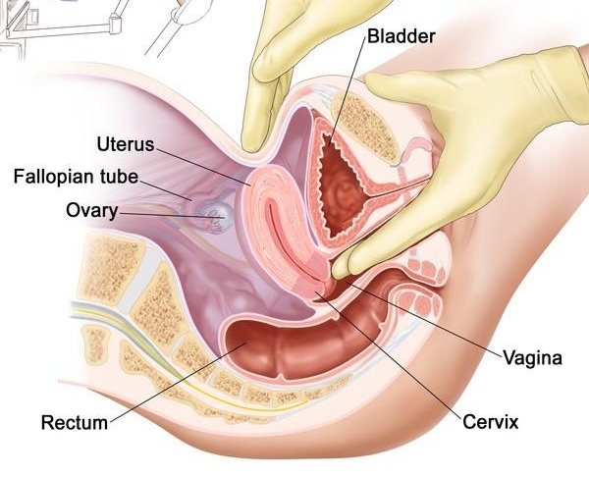
Bimanual Exam
Systematic exam:
  Find cervix
  Find fundus
  Determine relative hand position (internal and external hands)

Slide 14
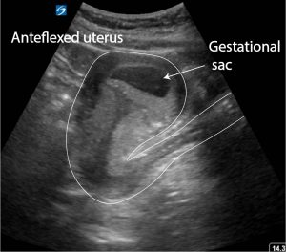
Why does this matter?
Notes:
Ultrasound in first tri procedures does not reduce risk of perforation overall, but can be used especially in training
Actual case with resident
Perforation posteriorly likely because
Anteversion not recognized
Misdirection of dilators or sound (too posterior)
Not enough traction on tenaculum to straighten out anteversion
Too much pressure when dilating

Slide 15
Why does this matter?
Notes:
Ultrasound in first tri procedures does not reduce risk of perforation overall, but can be used especially in training
Actual case with resident
Perforation posteriorly likely because
Anteversion not recognized
Misdirection of dilators or sound (too posterior)
Not enough traction on tenaculum to straighten out anteversion
Too much pressure when dilating

Slide 16
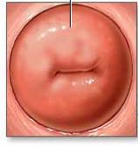
Visualize Cervix & Place Tenaculum
1 – Where does tenaculum go?
12 o’clock
2 – Distraction tips for tenaculum placement?
3 – Where does the paracervical block go?
3 and 9 o’clock at lateral folds
Notes:
What is at 3 and 9? Arteries!
Most providers use ant lip of cervix, may use posterior lip for retroverted uteri.

Slide 17
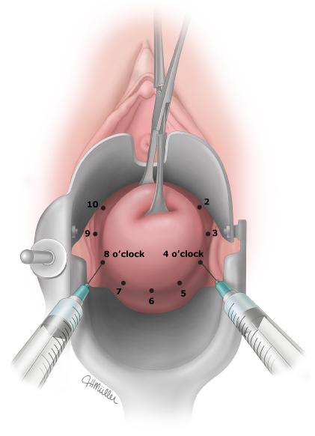
Paracervical Block
Notes:
Multiple different ways to do this. 10mL 1% lidocaine with 10mL NS
First, place 1-2 cc at the tenaculum site, clamp tenaculum
Various methods.
Most simple would be 2 additional sites, 2 and 10 OR 4 and 8 at cervicovaginal reflection.

Slide 18
Cervical Dilation & Aspiration
Cervical dilation
  No Touch Technique
  No need for cervical antiseptic
Uterine Evacuation
  Appropriate cannula size
    *Generally = GA or GA -1
  For PUL eval, cannula size 6-7mm usually sufficient
Tissue evaluation
  Identification of gestational sac, decidua & villi
Notes:
For both first- and second-trimester procedures, the reported rate of uterine perforation is less than 0.6 percent [59-61]. Among first-trimester procedures alone, one study of 170,000 patients had only 16 cases (<0.01 percent) of uterine perforation requiring additional measures
N=1 or one size down.

Slide 19
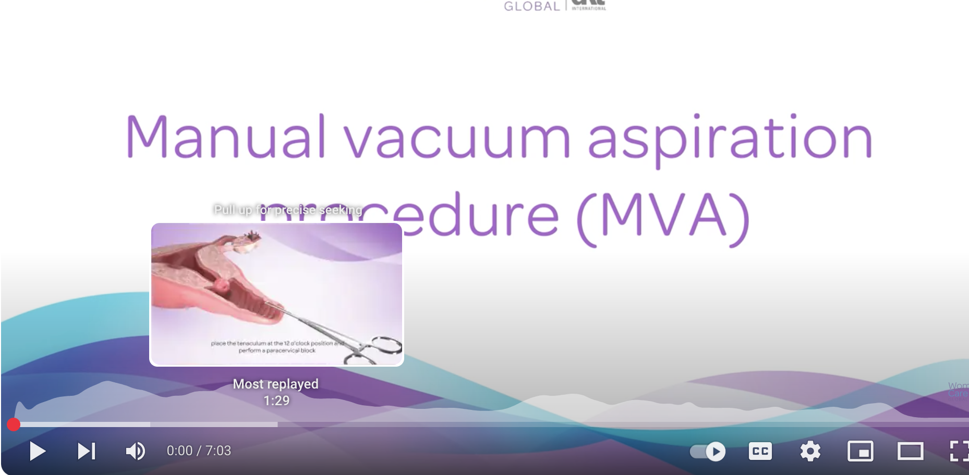
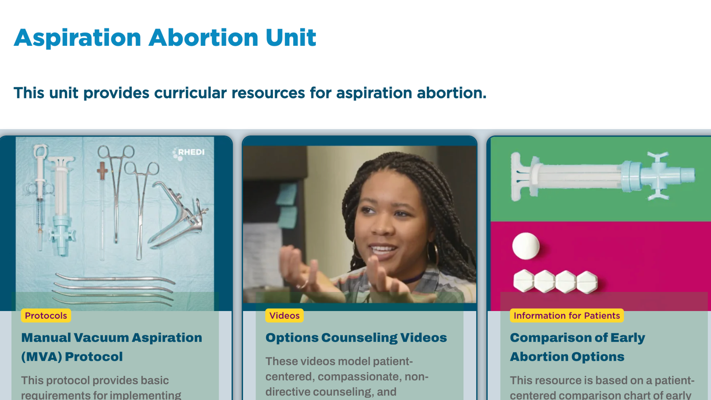
Demonstration Videos
DEMO VIDEO: https://www.youtube.com/watch?v=GuBjk3Br7GE
GREAT RESOURCE: https://rhedi.org/aspiration-abortion-unit/

Slide 20
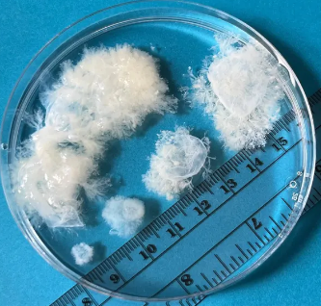
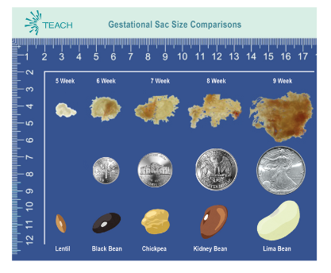

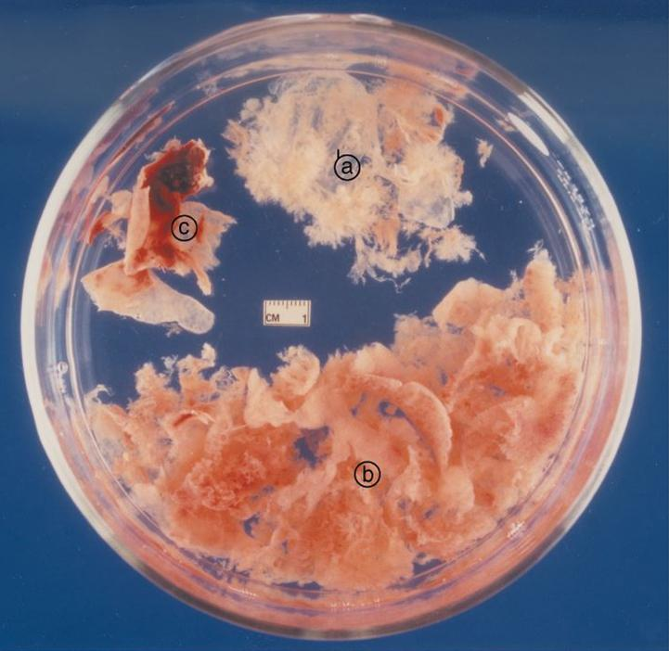
Tissue Evaluation
https://bpac.org.nz/ema/procedurem3.aspx
Notes:
3 components: decidua, villi, sac

Slide 21


TEACH WORKBOOK PDF: https://drive.google.com/file/d/1H87INfG4ybE8nePYKrkCKczKp_qNOmYC/view
Notes:
3 components: decidua, villi, sac
https://drive.google.com/file/d/1H87INfG4ybE8nePYKrkCKczKp_qNOmYC/view

Slide 22

Questions?

Slide 23

Let’s Practice!
Notes:
https://www.youtube.com/watch?v=GuBjk3Br7GE

