Slide 1
Welcome!
Misbah Keen, MD, MPH, MBI
Director
Joel Carey, MD, MPH
Assistant Director
Toby Keys, MA, MPH
Associate Director
Max Keyes – fmclerk@uw.edu
Clerkship Program Manager

Slide 2
Goals & Objectives of the Family Medicine Clerkship

Slide 3
Goals
Learn and apply key components of the Family Medicine approach to health care:
Biopsychosocial Aspects of Care
Comprehensive Care
Continuity of Care
Context of Care
Coordination and Integration of Care
Buffalo, WY
Notes:
1. Patients’ health impacted by body, mental, environment; 2. Lots of different forms of care; 3. Longitudinal care; 4. Where they get care (ER, clinic, home visit); 5. Coordinate within clinic

Slide 4
Clerkship Objectives: Patient Care
Conduct the medical history using patient-centered communication with patients across the lifecycle. (Item is double-weighted)
Perform the appropriate physical examination with patients across the lifecycle. (Item is double-weighted)
Present well organized, appropriately focused and accurate oral case presentations for common patient presentations across the lifecycle. (Item is double-weighted)
Propose an initial diagnostic plan for patients with common primary care presentations. (Item is double-weighted)
Offer and communicate management plans for patients with common primary care presentations, including acute, chronic, and health maintenance visits, using collaborative decision making with patients. (Item is double-weighted)
Notes:
Discussion with site directors

Slide 5
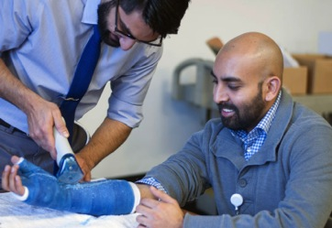
Clerkship Objectives: Knowledge for Practice, Interpersonal & Communication Skills, Personal & Professional Development
6. Apply established and emerging scientific principles of clinical sciences to diagnostic and therapeutic decision making, clinical guidelines, and other aspects of evidence-based health care. (Item is double-weighted)
7. Produce complete and accurate write-ups for common patient presentations across the lifecycle. (Item is double-weighted)
8. Demonstrate full range of patient-centered communication skills in multiple clinical settings. (Item is double-weighted)
9. Demonstrate demeanor that puts patients, families, and members of the health care team at ease. (Item is double-weighted)

Slide 6
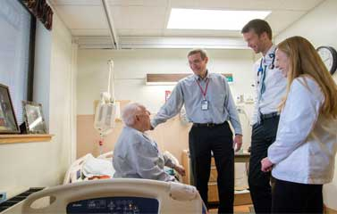
Clerkship Objectives: System-based Practice, Practice-based Learning, Interprofessional Collaboration, & Professionalism
10. Coordinate patient care within the health care system.
11. Identify and perform learning activities to address gaps in knowledge, skills and/or attitudes.
12. Demonstrate effective partnership with others as a member of the health- care team or other professional group.
13. Demonstrate professionalism throughout the clerkship.

Slide 7
Required Activities

Slide 8
Required Activities
Week One
Site Orientation
Clerkship Orientation Webinar
Assignment and Clinical Encounter Trackers
EPCC
Week Three
Mid-Clerkship Review
Photo: Quinn Rivera | Cody, WY
Notes:
Observation form (mini CEX)

Slide 9
Required Activities
Week Six
Final Exam
End of Clerkship Review
End of Week Six
Site and Faculty Evaluations
Pocatello, ID

Slide 10
The FM Clerkship Webpage: www.uwfmc.org

Slide 11
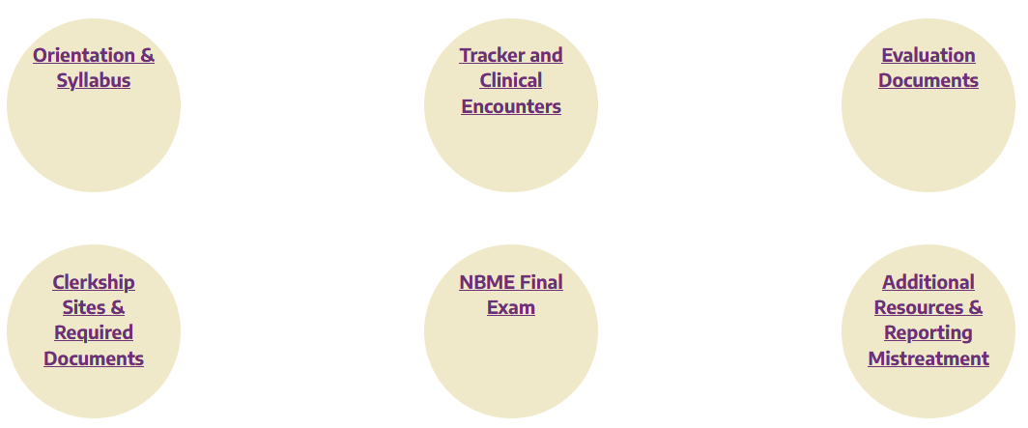
http://www.uwfmc.org/ Left menu: Info for Students

Slide 12
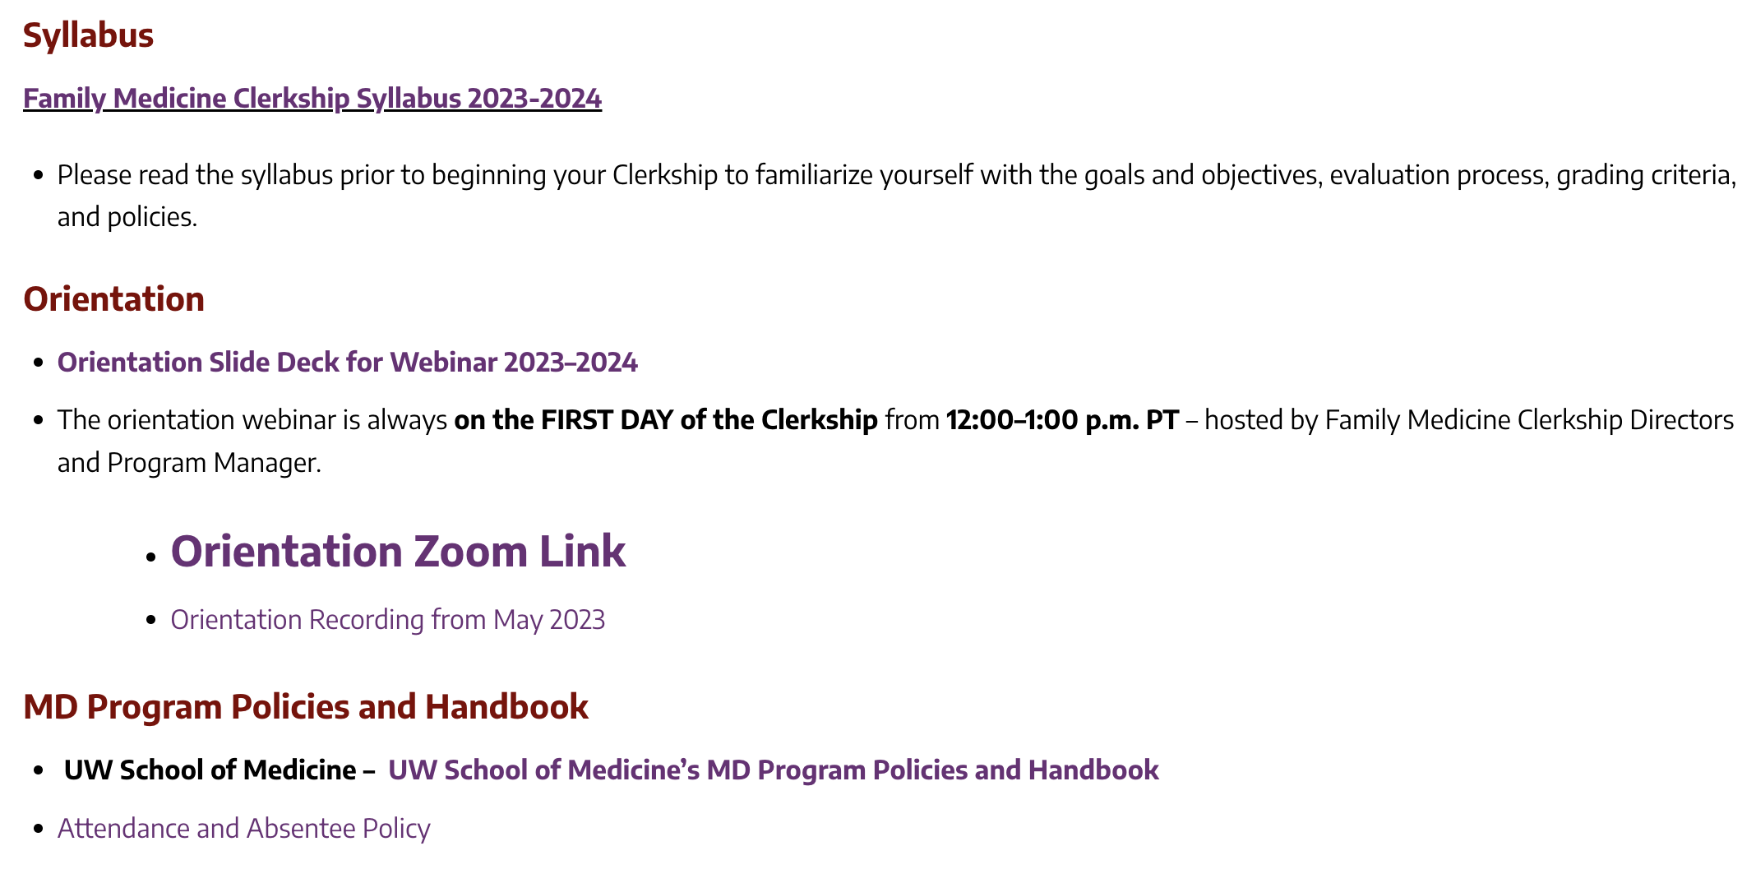
Orientation & Syllabus

Slide 13
Orientation & Syllabus (continued)

Slide 14
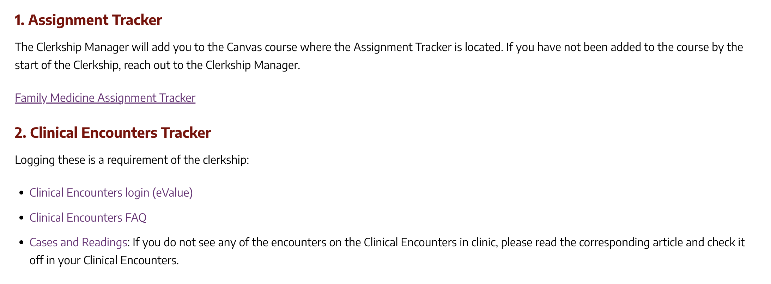
Assignment and Clinical Encounters Trackers

Slide 15
Assignment Tracker
Track all curricular activities and timelines on Canvas
Update Assignment Tracker WEEKLY
Review tracker with preceptor at Mid-Clerkship and End-of-Clerkship Reviews
Failure to complete the Assignment Tracker by the end of clerkship rotation will result in a Professional Concern and will likely negatively impact your overall grade.
Notes:
Review at midclerkship review with preceptor to prepare for second half.
There is a long list of clinical opportunities, you only have to track the required ones on e-value. The rest are there to offer you an idea of opportunities to look for

Slide 16
Clinical Encounters Tracker on E*Value
You may log clinical encounters every time you see them if you’d like, but you only need to log them once per type.
If you are unable to see any of the required clinical encounters, you may complete a reading. See our website for the readings.
Failure to complete the Clinical Encounter tracker by the end of clerkship rotation will result in a Professional Concern and will likely negatively impact your overall grade
Notes:
Log these for the broader SOM

Slide 17
Required Clinical Encounters: Acute
On the Assignment Tracker, there is a list of other common presentations that are NOT required but may guide your reading and choice of clinical encounters
1. Low Back Pain
2. Fever
3. Asthma
Notes:
14 required experiences for FM; evidence-based articles. Upper respiratory infections; UTIs;

Slide 18
Required Clinical Encounters: Chronic
4. Depression
5. Type 2 Diabetes
6. COPD
7. Childhood ADHD
8. Substance Abuse and Dependence
9. Chronic Pain Management
10. Prenatal Management

Slide 19
Required Clinical Encounters: Preventive Care
11. Health Maintenance Adult Male 45-75
12. Health Maintenance Adult Female 45-75
13. Health Maintenance Adult Female (Reproductive Age) 14-45
14. Childhood Immunizations

Slide 20
Effective Patient Centered Care (EPCC)
WEEKS 1 - 3
Learn EPCC concepts through:
Articles
Online Training
Videos
Direct Observations
Notes:
Formative feedback. Linked to A.T.

Slide 21
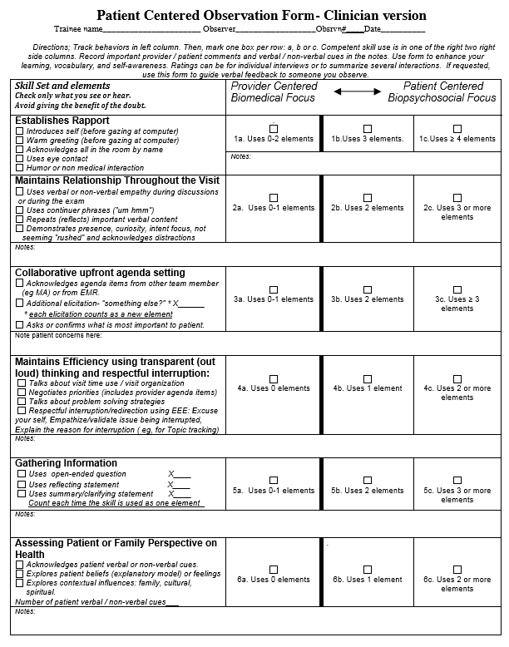
Effective Patient Centered Care (EPCC) Mini-CEX for FMC:
WEEKS 4-6
Apply EPCC concepts into practice using the Patient Centered Observation Form
Use form 3-4 times
Link to training and downloadable forms: www.pcof.us
Note: It is OK to break this up into sections, but please do full PCOF in one visit at least once during rotation.
Notes:
4 times being observed; 2 times observing preceptor

Slide 22
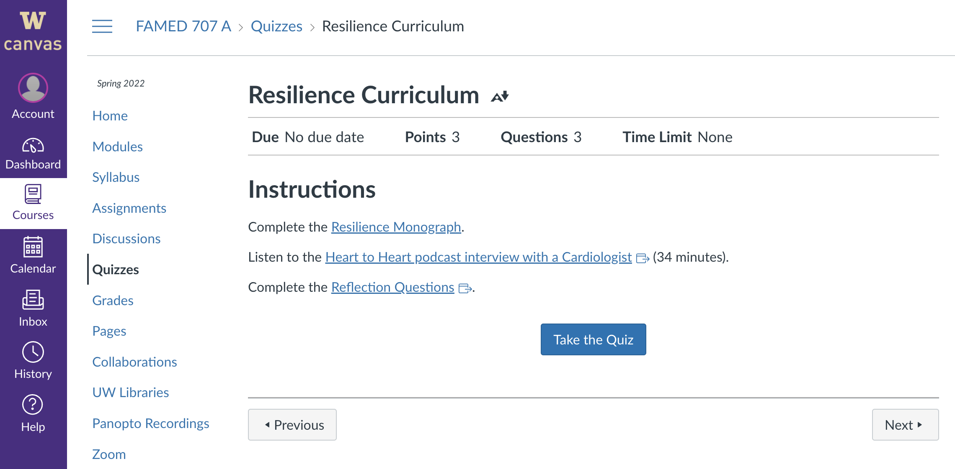
Resilience Curriculum

Slide 23
Professionalism
Review:
Professional expectations of the clerkship
Professionalism section of Feedback & Evaluation form
Discuss professional performance at Mid & End of Clerkship Review - REQUIRED
Professionalism Award Nominations:
Student Award
Staff and Faculty Award
Three students being awarded the Student Professionalism Award in 2022
Notes:
Review the professionalism on site on Info for Students. Finalists get to put on Dean’s Letter. Also get to nominate a faculty or staff.

Slide 24
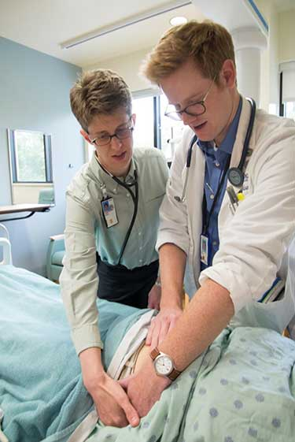
Professional Learning Environment
Teacher-Learner Relationships: Both have rights and responsibilities
1. Responsibilities of Teachers:
Treat learners fairly, respectfully, and without bias related to their age, race, gender, sexual orientation, disability, religion, or national origin.
Give learners timely, constructive, and accurate feedback.
Notes:
Skim this- solicit feedback.

Slide 25
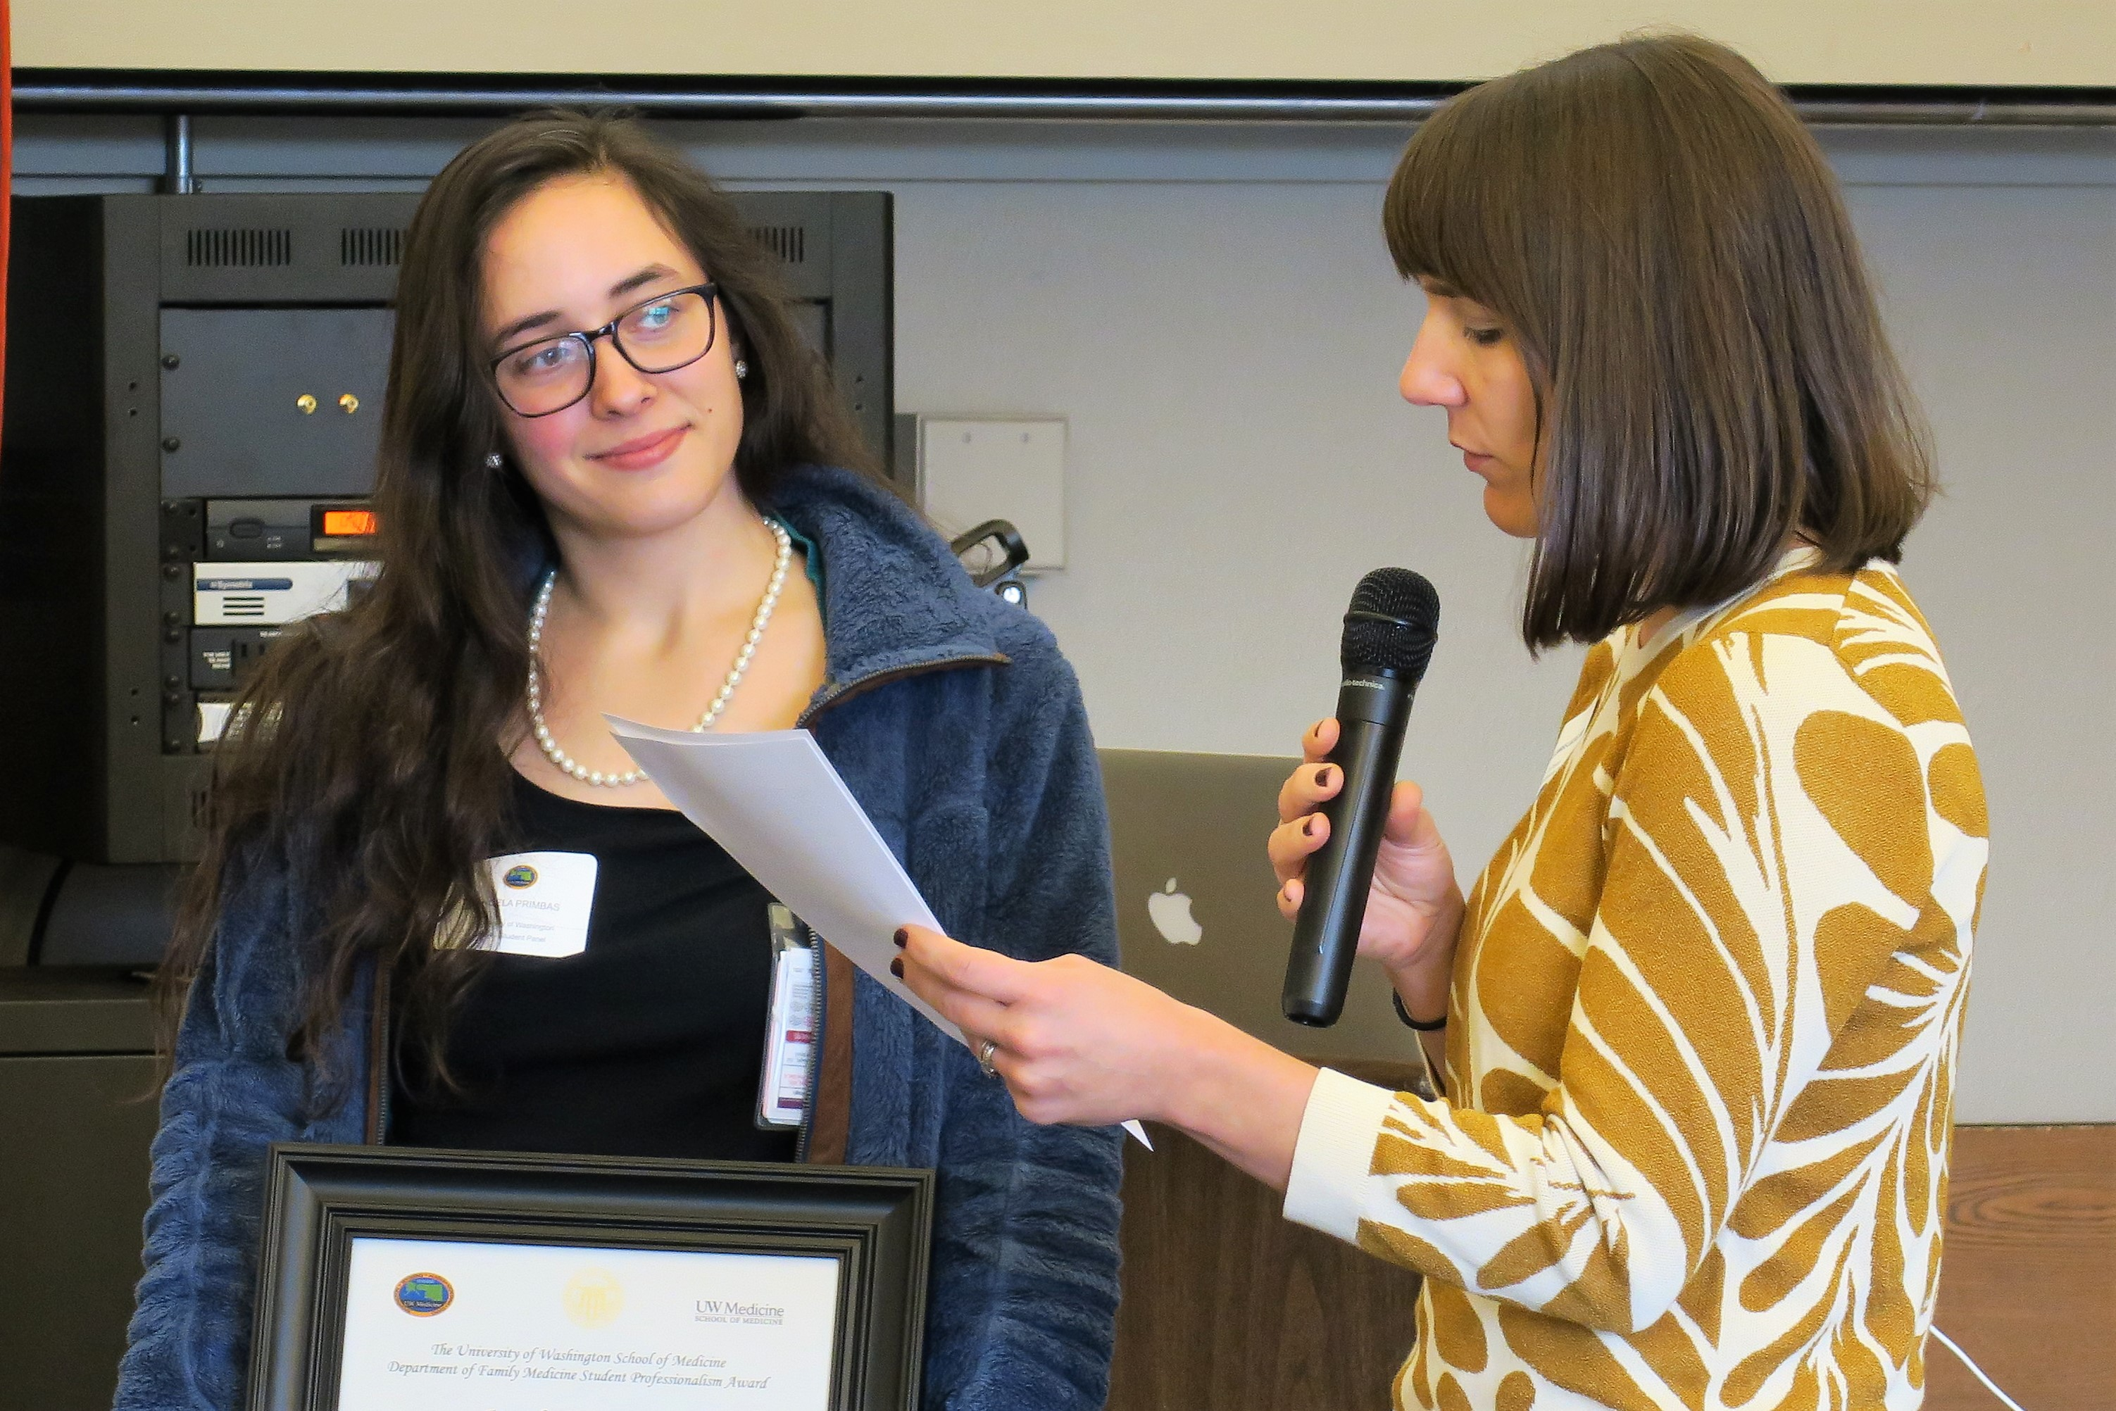
Professional Learning Environment
2. Responsibilities of Learners:
Be courteous and respectful of others.
Put patients' welfare ahead of educational needs.
Know limitations and ask for help when needed.
Maintain patient confidentiality.
View feedback as an opportunity to improve knowledge and performance skills.
Student Professionalism Award being presented to Angela Primbas by Dr. Jeanne Cawse-Lucas
Notes:
Emphasize how we want to build better teachers so want feedback;

Slide 26
Learning Environment Concerns
Reporting Mistreatment or a Serious Concern:
To report mistreatment or a serious concern that doesn’t require immediate response, use the Learning Environment Feedback Tool.
You are able to provide a description of your concern and indicate your follow-up preference and how you would like your feedback shared.
You will have the option of reporting completely anonymously or indicating how you want your identity and the identity of anyone else involved in the situation to be shared.
http://blogs.uw.edu/esom/learning-environment/
Notes:
Can list the names of preceptors to contact if want to (optional). We have closed a site and fired faculty as result. No action taken until after the grades are in unless time critical for student. Common Reporting System. Report mistreatment/preceptor/site. Goes to Dean of Students Affairs and Dean of Curriculum.

Slide 27
FM Final Exam & Evaluations

Slide 28
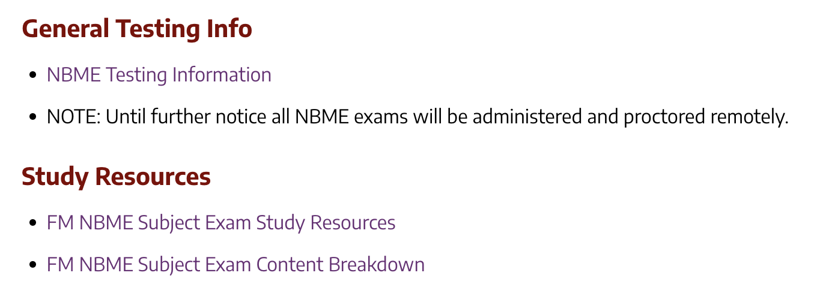
NBME Final Exam

Slide 29
FINAL EXAM
Final Exam: The last Friday of the clerkship
*Testing will remain remote until further notice.
Family Medicine Subject Exam
Questions: 90
Time: 2 hours 15 minutes
Anacortes, WA

Slide 30
FINAL EXAM CONTENT
The % indicates the frequency at which the topic typically appears in the exam (e.g. 15-20% of exam questions deal with patients aged birth to 17 years) Headings are groupings based on topics
System
General Principles, Including Normal Age-Related Findings and Care of the Well Patient 5%–10%
Immune System 1%–5%
Blood & Lymphoreticular System 1%–5%
Behavioral Health 5%–10%
Nervous System & Special Senses 1%–5%
Skin & Subcutaneous Tissue 3%–7%
Musculoskeletal System 5%–10%
Cardiovascular System 5%–10%
Respiratory System 5%–10%
Gastrointestinal System 5%–10%
Renal & Urinary System 1%–5%
Pregnancy, Childbirth, & the Puerperium 1%–5%
Female Reproductive System & Breast 1%–5%
Male Reproductive System 1%–5%
Endocrine System 5%–10%
Multisystem Processes & Disorders 1%–5%
Biostatistics, Epidemiology/Population Health, & Interpretation
of the Medical Lit. 1%–5%
Social Sciences 5%–10%
Communication and interpersonal skills
Medical ethics and jurisprudence
Systems-based practice and patient safety
Physician Task
Health Maintenance, Prevention & Surveillance 20%–25%
Diagnosis, including Foundational Science Concepts 40%–50%
Pharmacotherapy, Intervention & Management 25%–30%
Site of Care
Ambulatory 100%
Patient Age
Birth to 17: 15%–20%
18 to 65: 55%–65%
66 and older: 15%–20%

Slide 31
FINAL EXAM STUDY MATERIALS
Books/eBooks
Step-Up to Family Medicine. Outline format. Easy to get through in six weeks. Written specifically for success in the Family Medicine Clerkship and on the subject exam.
Review articles in the library at AAFP.org. Most of the alternative-assignment readings for clinical encounters are from this site.
Case Files Family Medicine. Good if you learn best through case studies. You may be able to complete the book in six weeks.
Essentials of Family Medicine. Very good book, but very long. May be difficult to get through in 6 weeks.
Dylan LeBlanc, Bozeman, MT

Slide 32
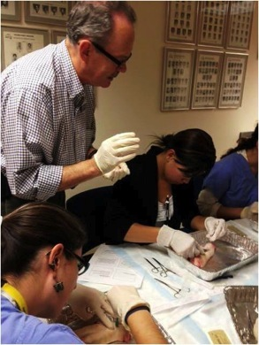
FINAL EXAM STUDY MATERIALS
Exam Practice Questions:
Book: Family Medicine PreTest Self-Assessment And Review. If you like Pretest for other clerkships, you will probably like it for this clerkship as well.
Website: AAFP board review questions
Become a student member for free here: https://www.aafp.org/membership/join/student.html
It takes a few days to activate your account, so sign up early in your rotation.
You will have access to the board review questions. Past students have found these very helpful.
Well over 1,000 questions. On average, the question stems may be a little shorter than the ones on the subject exam.
Tacoma FMR

Slide 33
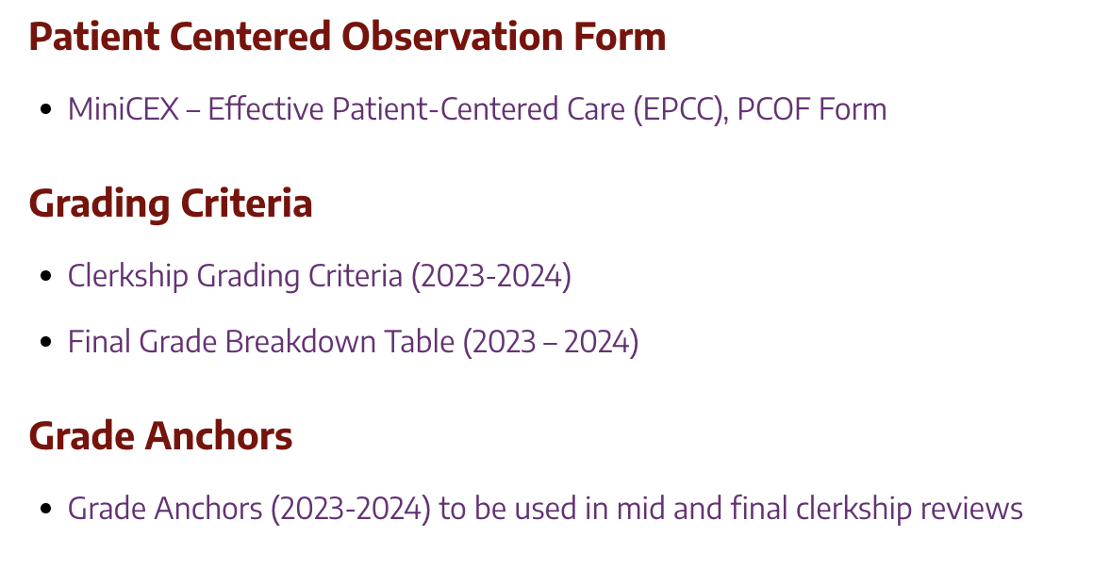
Evaluation Documents

Slide 34
Evaluation Process
Site Director collects feedback from preceptors about student’s performance.
Final grades are assigned by Clerkship Directors at the Seattle office based on the site’s scores and final exam performance.
Site Director incorporates feedback into preliminary grade form considering depth, length of time, and when each faculty worked with the student.
Notes:
Little differences- Weigh feedback by first half and second half. We want to be transparent. In your final eval, you will see the evaluations from your preceptors but won’t go in Dean’s Letter. If you use daily feedback cards, this is when they are used.

Slide 35
Feedback & Evaluation Form (Grade Anchors)
Notes:
Used by all site directors. Used to combine all preceptor info to one evaluation

Slide 36
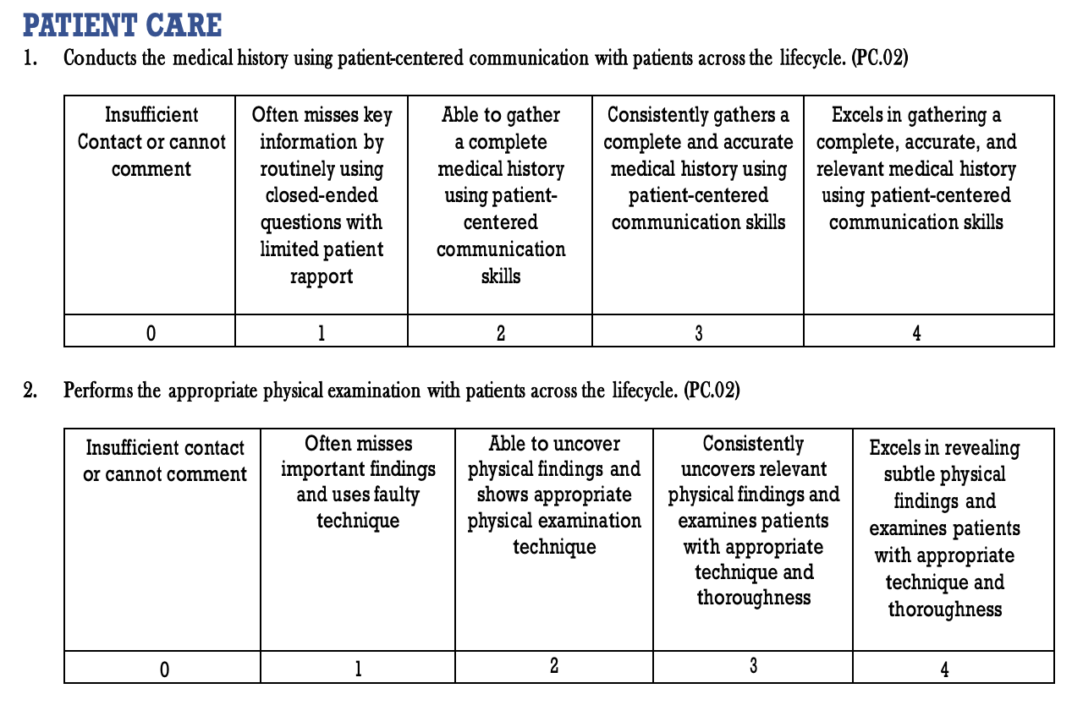
Example of Grade Anchors
Notes:
Used by all site directors. Used to combine all preceptor info to one evaluation

Slide 37
Weighted Grading Anchors All items are double-weighted / 2X the points except:
Demonstrates demeanor that puts patients, families, and members of the health care team at ease.
Coordinates patient care within the health care system.
Identifies and perform learning activities to address gaps in knowledge, skills and/or attitudes.
Demonstrates effective partnership with others as a member of the health-care team or other professional group.

Slide 38
Clinical Grading Criteria
Clinical Numeric Grade | Numeric Point Range out of 80 | Percent Range
Honors | 76 to 80 | 95% or higher
High Pass | 62 to 75 | 77.5% to 94.9%
Pass | 40 to 61 | 50% to 77.4%
Fail | Less than 40 | Less than 50%
Notes:
SKIM THIS

Slide 39
Exam Grading Criteria
The exam is 20% of your final grade
Exam score of 58 or lower (second percentile) is a fail
You can still pass the clerkship if you fail the exam
Example:
81 score on the exam divided by 5 = 16.2 points
If clinical grade is 70, the final grade = 86.2/100 points
There is no rounding.
Notes:
SKIM THIS

Slide 40
Final Grading Criteria
Final Grade | Numeric Point Range out of 100
Honors | 91 to 100
High Pass | 76 to 90.99
Pass | 52 to 75.99
Fail | Less than 52
One “No” for a Professionalism item will lower the final grade by one tier- with exception of those who received a final pass grade.
Two or more “Nos” for Professionalism items or one egregious breach in professionalism may result in a final grade of Fail. If students receive a professional concern from the FM Clerkship Office about either an incomplete clinical encounter(s) or assignment(s) the final grade will be lowered by one tier- with exception of those who received a final pass grade.
Notes:
SKIM THIS

Slide 41
Grade Challenges
If you wish to dispute your final grade, the Grade Challenge form must be completed and received by our office within 4 weeks after your grade was posted.
Circumstances in which a challenge is appropriate include:
An apparent mathematical error in computing your final grade.
A technical problem with the evaluation process.
Circumstances in which a challenge will not be entertained include:
Performance on the exam or the weight of exam.
Disagreement with our grading process (e.g. how the clinical grade is calculated and weighted).
Disagreement with the evaluator’s assessment of your performance.
Discrepancy between the feedback you received and the evaluation that was submitted.
Disagreement with final comments vs. final grade.
Notes:
SKIM THIS

Slide 42
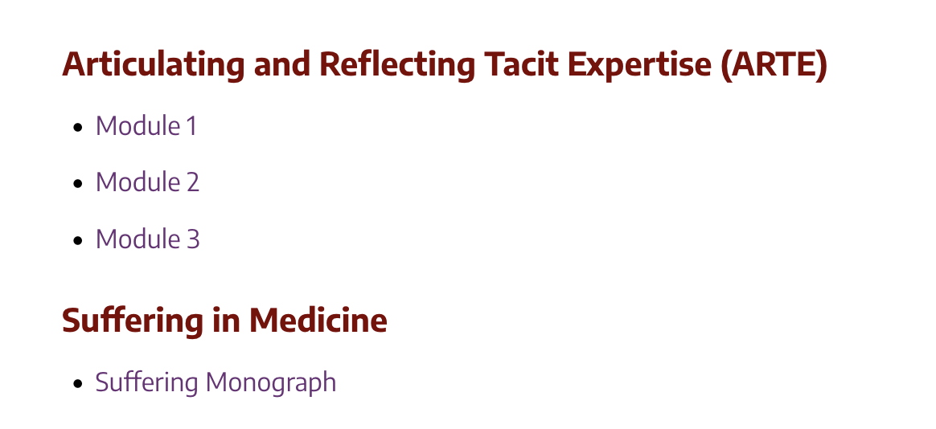
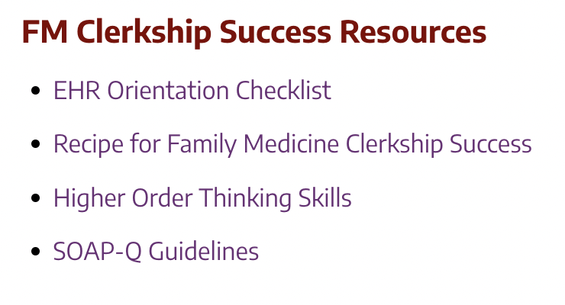
Additional Resources

Slide 43
A Recipe for Family Medicine Clerkship Success
> Professionalism, More Resources, & Reporting Mistreatment
Examples of Helpful Tips:
It's essential to know your patients well, which includes reading up on their illnesses and upcoming surgeries. You can also do the corresponding articles/cases that pertain to a patient’s diagnosis (see the assignment tracker for details)
Participate (even if you are shy or uncertain) and don't be afraid to get answers wrong! A majority of students commented that being wrong is not nearly as important as students fear it is. Go back and find out the answer to a question you got wrong and report back to your team. One medical student said, "Answering questions wrong is NOT a red flag, but not trying is."
Oral presentations are very important so put in the time to do them well. They should be well-organized and CONCISE, touching on only the most important details. Keep in mind the goal of the presentation-to convey information to your attendings and the team.
Notes:
How to make this the best learning experience, which results in the best grades.

Slide 44
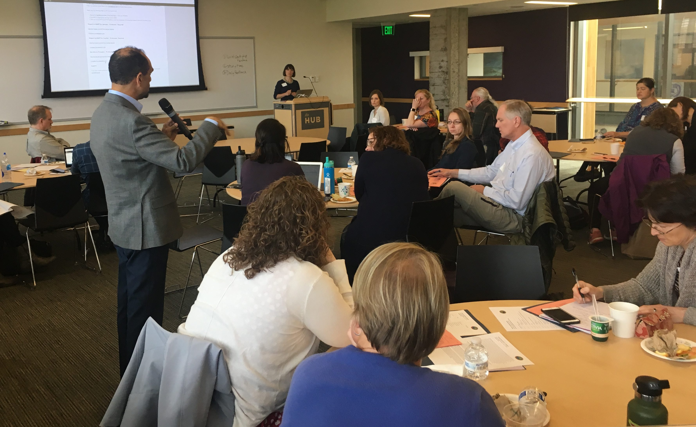
Family Medicine Faculty Development
Teaching sites receive four days of clerkship faculty development annually

Slide 45
QUESTIONS?
YOU CAN ALWAYS CONTACT US AT
fmclerk@uw.edu

