Slide 1
The Six Building Blocks Clinic-Wide Kickoff
A Team-Based Approach to Improving Opioid Management in Primary Care
  The Six Building Blocks program has received funding from the Agency for Healthcare Research & Quality (R18HS023750), the Washington State Department of Health (Subcontract HED23124 of Cooperative U17CE002734, funded by the CDC), and the Washington State’s Olympic Communities of Health. Its contents are solely the responsibility of the authors and do not necessarily represent the official views of CDC, NIH, the WA State Department of Health, or the Olympic Communities of Health. The Six Building Blocks Train-the-Trainer program is funded by the National Institute on Drug Abuse (Award UG1DAO13714). This program has not been reviewed by NIDA and does not necessarily reflect the views of the Institute.
Notes:
Our organization is offering a program called the Six Building Blocks to its clinics. This program offers an opportunity for primary care clinics to apply a team-based approach to improving opioid management for patients with chronic pain.

Slide 2
Agenda
Overview of the opioid problem, guidelines, regulations, and the Six Building Blocks Program
Why is this work important to us?
Small group discussions of our clinic’s current approach
to long-term opioid management and priorities for
change
Program next steps and how you can help

Slide 3

130
Americans
die every day from an
opioid overdose
that includes
prescription opioids
and heroin
Notes:
Our organization is taking part in this program because we want to prescribe opioids as responsibly as possible given the serious problems that are associated with opioid prescribing in the U.S. In addition we are taking part because <PUT YOUR REASONS HERE>. Practices have told us that they take part for the following types of reasons: 1) to provide the best evidence-based care for patients with chronic pain, 2) to address the stress that some providers and staff experience in caring for patients with chronic pain who use long term opioid therapy.
Then present the information on this and the following 3 slides.
https://www.cdc.gov/drugoverdose/epidemic/index.html

Slide 4
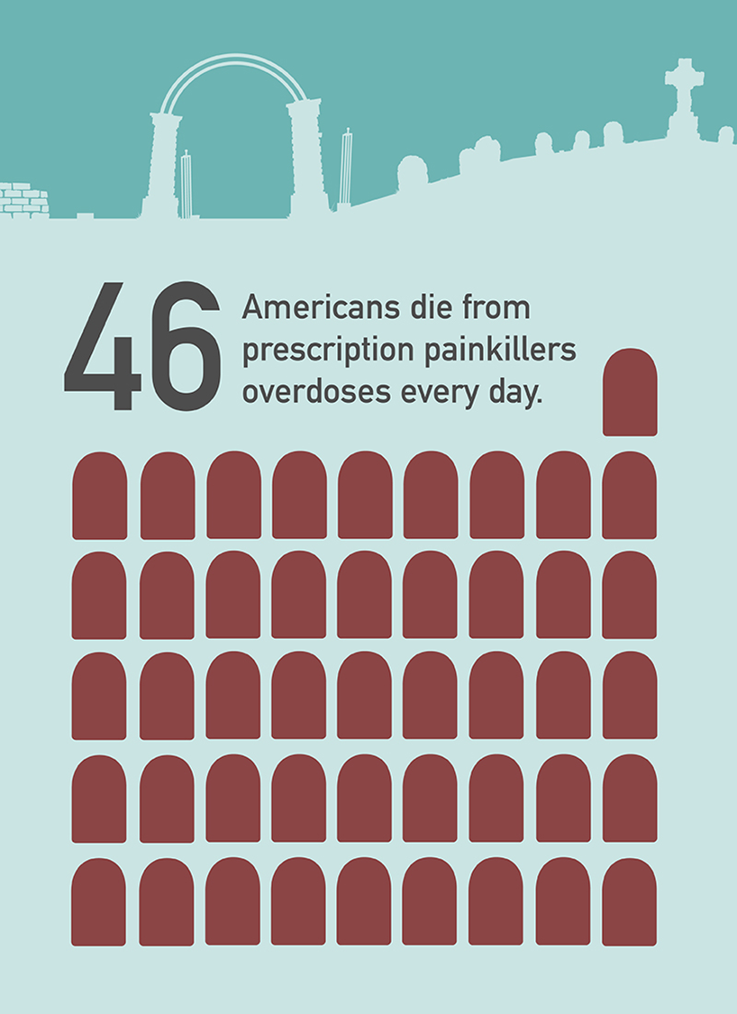
Notes:
Roughly 46 people died every day from overdoses involving prescription opioids www.cdc.gov/drugoverdose/data/overdose.html
https://www.cdc.gov/mmwr/volumes/67/wr/mm675152e1.htm?s_cid=mm675152e1_w
This article shows that 36% of opioid-related overdose deaths in 2017 involved prescription opioids.

Slide 5
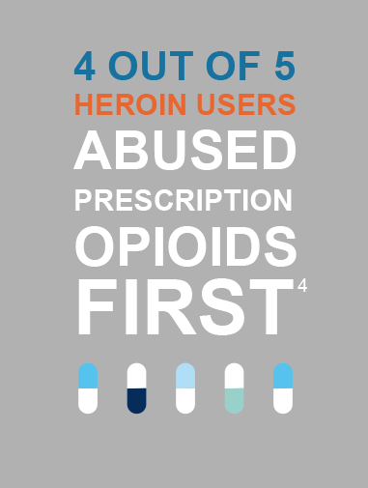
Notes:
https://www.drugabuse.gov/drugs-abuse/opioids/opioid-overdose-crisis#seven
The increase in illicit opioids and high levels of prescription opioid use are related. In Rhode Island, 24 of the 69 people (35%) who died from an illicit fentanyl overdose between January 2012 and March 2014 had filled an opioid prescription within 90 days of death.⁵

Slide 6

In THE U.S.,
there WEre
59 opioid
prescriptions written for every 100 people IN 2017.
Notes:
And with the majority of opioid prescriptions written by primary care providers, it’s important that our organization does its part to manage opioids as responsibly as possible. That’s why I am excited about the opportunity that the Six Building Blocks program offers to help us do so.
https://www.cdc.gov/drugoverdose/maps/rxstate2017.html
US: 58.9 in 2017
Yet the amount of opioids prescribed in 2015 remains more than 3 times higher than in 1999, when the amount prescribed was 180 MME per capita, and is nearly 4 times higher than in Europe in 2015.
From 2006 to 2015, the average duration of opioid prescriptions increased by a third, from 13.3 to 17.7 days.

Slide 7

In XXX COUNTY, there WEre
XX opioid
prescriptions written for every 100 people IN 2017.
Notes:
ASK YOUR SITE IF THEY WANT TO SHARE THIS SLIDE OR NOT. IT IS MOTIVATING FOR SOME SITES AND UPSETTING TO HEAR FROM AN OUTSIDER FOR OTHERS.
https://www.cdc.gov/drugoverdose/maps/rxcounty2017.html
Update with your county information.

Slide 8
Opioid Overdose Risk
Dunn et al Ann Intern Med 2010

Slide 9
What do the guidelines say?
CDC Recommendations:
Opioids are not first-line therapy
Establish goals for pain and function
Discuss risks & benefits
Use immediate-release opioids when
starting
Use the lowest effective dose
Prescribe short durations for acute pain
Evaluate benefits & harms frequently
Use strategies to mitigate risk
(e.g., naloxone)
Review PDMP data
Use urine drug testing
Avoid concurrent opioid & benzodiazepine prescribing
Offer treatment for Opioid Use Disorder
Notes:
Update as guidelines change, and/or add other guidelines, as applicable.

Slide 10
What regulations do we need to know?
Notes:
Add relevant information about your state and local regulations, as applicable. For example, for Washington…
Washington state 1427 rules provide state-specific guidance for prescribing and monitoring opioids
• Register with and use the PDMP: Prescription Drug Monitoring Program
• Provide information on opioid risks, safe storage, and disposal, and document that you provided this information
• No prescribing of opioids if patient is using a sedative without documentation of risks, consultation with prescriber of sedative, consideration of tapering
• Ensure high risk patients have naloxone
• Base your frequency of visits, PMP checks, urine drug tests on patient risk status
• Encourages care of patients with legacy prescriptions

Slide 11

The Six Building Blocks:
Supporting clinics in implementing best practices for opioid management
Notes:
It can help to have support when aligning with guidelines and regulations. That’s what the Six Building Blocks does… tailors support to a practice’s opioid management improvement goals.

Slide 12
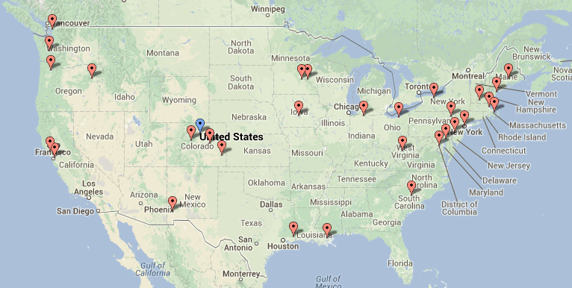
The Six Building Blocks derive from observations of approaches taken among 20 primary care practices across the U.S. that were identified as having exemplar, team-based workforce innovations
Learning from Effective Ambulatory Practices (LEAP) study

Slide 13
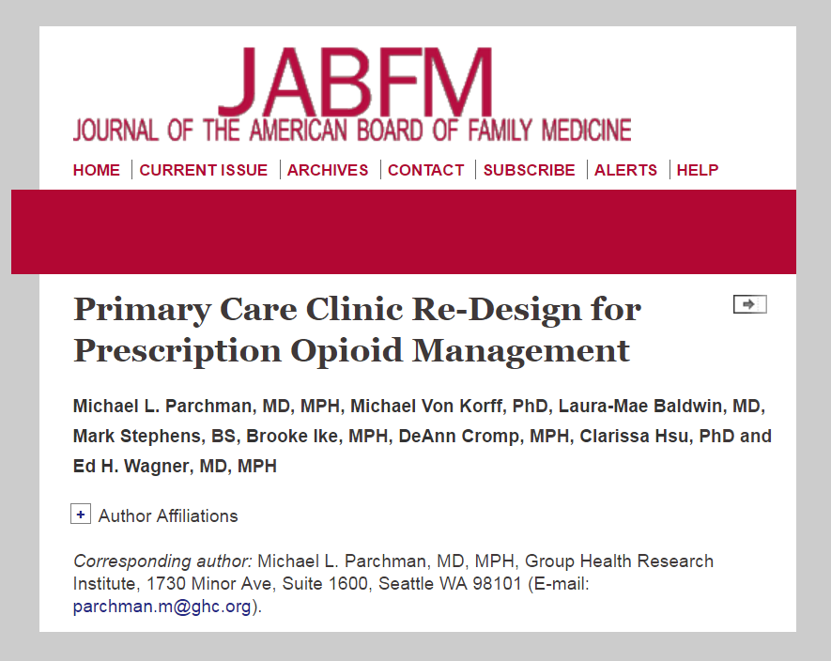
Learnings from these practices organized into the Six Building Blocks of Safer Opioid Management and published in the Journal of American Board Family Medicine in February 2017
Notes:
http://www.jabfm.org/content/30/1/44.full#abstract-1

Slide 14
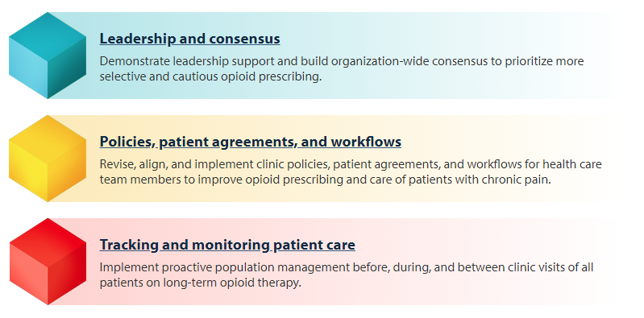
The Six Building Blocks

Slide 15
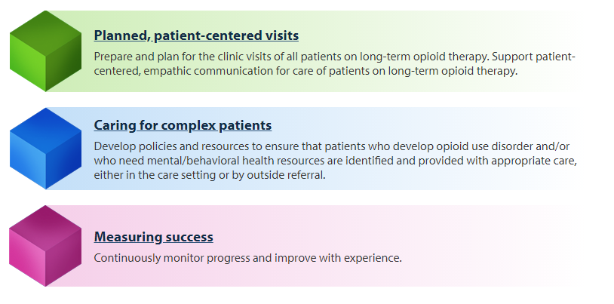
The Six Building Blocks

Slide 16
Studying the Six Building Blocks Program
  Developed a program to guide primary care organizations in implementing the Six Building Blocks
  Tested in 20 rural and rural-serving clinics in eastern WA and ID
Notes:
Best practices include:
-- implementation of policies and procedures that match with the CDC guidelines for opioid management
-- use of the PMP
-- UDT
-- referral of patients with OUD to treatment
-- avoidance of opioid and sedative co-prescribing
-- initiating difficult conversations with patients on high doses of opioids about tapering
Practice coach meets with practices quarterly and as needed to support the development and implementation of a practice “action plan.”
Practices learn from each other through monthly virtual learning collaborative calls
Coach connects patients with telepain conferences, which include short didactic presentations and case presentations of difficult cases with a multidisciplinary team of pain “experts”
Provides simple tools to assist with tracking opioid use and management.

Slide 17
Six Building Blocks Program
Development of an Opioid Improvement Team
Clinic-wide Kickoff
Ongoing guidance from a Practice Coach
Shared learning with others who are doing this project
Clinical education for providers and staff through UW TelePain (see handout)
Action plan development to implement relevant Six Building Block elements, such as:
    Revised policies, patient agreement, workflows
    System for tracking and monitoring opioid patients
    Patient education materials and behavioral health resources
    Complex patient resources

Slide 18
Six Building Blocks Program Prescribing Outcomes
The number of patients using long-term opioid therapy (LtOT) and the proportion on high dose opioids decreased

Slide 19
Six Building Blocks Clinician & Staff Experiences
  Increased confidence and comfort in caring for patients with chronic pain using long term opioid therapy
  Increased collaboration and teamwork across the clinic
  Decreased stress in providing care to patients using long-term opioid therapy
  Improved relationships with patients using long-term opioid therapy
      Seeing patients were receptive to change
      Fewer negative interactions
Notes:
Here talk about how decreased stress, increased comfort and improved relationships can increase the likelihood of a therapeutic alliance that minimizes stigmatization of patients with chronic pain using LtOT

Slide 20
Six Building Blocks Clinician & Staff Experiences
"Having a defined care pathway for an emotionally charged and complex area of care - to walk in with a plan. It's like walking into the ER and someone having a cardiac arrest. Not the most stressful thing I do because we have a clear plan. Now I have the same kind of pathway for opioids. Having what we are going to do defined.”
  “Everybody that works in this clinic says to me, ‘Do you remember how much turmoil there was around it? Wow, we don’t have any of that anymore.’”
  “The thing that surprised me was the number of patients that once they started churning through the standard care pathway, that said, ‘Wow, I get it,’ and then a lot of them just ended up tapering themselves ahead of us. I just wasn't quite prepared to see the patients engage.”

Slide 21
Why this work is important
(Insert slides from clinic perspective)

Slide 22
What’s happening at our clinic: data and stories
(Insert slides)

Slide 23
Where are we now?
A time for reflection & discussion

Slide 24

Diverse Perspectives
First step: gather an accurate baseline picture
Different roles and clinics = different perspectives
It is essential to get a sense of these different understandings to help build consensus & inform the quality improvement initiatives

Slide 25
Self-assessment activity directions
  Pick a “scribe”. That person will read the questions aloud and record answers. Write “scribe” on the top of that self-assessment.
  Each group will start on a different page, then continue and complete as many sections as time allows.
  As a group, please review each question and circle the number that best reflects your organization’s current status. Answers should reflect the clinic as a whole, not your individual practice.
  There are three number options for each answer to allow you to select how far along you are within that answer. If your group cannot agree, mark both scores and make a note.
  There are no right or wrong answers; we just want to gather perspectives from across the clinic and across roles.
  Prepare to share your scores and discussion points with the other groups.
  Time: 30 minutes
Notes:
*Give directions BEFORE breaking into groups*
Emphasize that they should consider the clinic as a whole, not their individual practices. Also, answer the questions based on what’s been going on in the past 3 months, not taking into account the recent focus on this issue.
4-5 people per group
Each group will start with a different BB and finish as many as they can in 30 minutes
(TELL THEM ABOUT THE SURVEY WHEN 10 MIN LEFT) If you need to leave, please turn in your survey on your way out.)

Slide 26
Small-group baseline self-assessment results

Slide 27
Leadership & Consensus
Leadership prioritizes the work | 1 2 3 | 4 5 6 | 7 8 9 | 10 11 12
The commitment of leadership in this clinic to improving management of patients on chronic opioid therapy… | …is not visible or communicated. | …is rarely visible, and communication about use of opioids for chronic pain patients is ad hoc and informal. | …is sometimes visible and communication about patients on chronic opioid therapy is occasionally discussed in meetings. | …is communicated consistently as an important element of meetings, case conferences, emails, internal communications, and celebrations of success.
Shared vision | 1 2 3 | 4 5 6 | 7 8 9 | 10 11 12
A shared vision for safer and more cautious opioid prescribing… | …has not been formally considered or discussed by clinicians and staff. | …has been discussed, and preliminary conversations regarding a clinic-wide opioid prescribing standard have begun. | …has been partially achieved, but consensus regarding a clinic-wide opioid prescribing standard has not yet been reached. | …has been fully achieved. Clinicians and staff consistently follow prescribing standards and practices.
Responsibilities assigned | 1 2 3 | 4 5 6 | 7 8 9 | 10 11 12
Responsibilities for practice change related to patients on chronic opioid therapy… | …have not been assigned to designated leaders. | …have been assigned to leaders, but no resources have been committed. | …have been assigned to leaders with dedicated resources, but more support is needed. | …have been assigned. Dedicated resources support protected time to meet and engage in practice change.
Notes:
Each group presents on their findings. 20 minutes. Keep in mind about 3 minutes per slide.
Each group will report on the section they started with, how they scored themselves and why. Next ask audience if that resonated with them or if they have a different experience they want to share.
In presenter view, you can mark/circle the answers on the slide.

Slide 28
Policies, patient agreements, and workflows
Policy development/ revision | 1 2 3 | 4 5 6 | 7 8 9 | 10 11 12
Comprehensive policies regarding chronic opioid therapy that reflect evidence-based guidelines, such as the CDC Guideline for Prescribing Opioids for Chronic Pain or state-based opioid prescribing guidelines… | …do not exist. | …exist, but have not been recently revised and updated. | …exist, have been recently updated, but are still lacking essential components. | …exist, and have been recently updated to reflect recent evidence-based guidelines, and are comprehensive.
Policy Implementation | 1 2 3 | 4 5 6 | 7 8 9 | 10 11 12
Policies regarding chronic opioid therapy… | …have not been distributed to clinicians and staff. | …have been distributed to clinicians and staff, but have not been discussed. | …have been distributed, have been discussed with all clinic staff and clinicians, but are not consistently followed. | …have been distributed, have been discussed with all clinic staff and clinicians, and are consistently followed.
Patient agreements | 1 2 3 | 4 5 6 | 7 8 9 | 10 11 12
Formal signed patient agreements regarding chronic opioid therapy… | …do not exist. | …exist, but do not align with current clinic policies and/or are not consistently used | …exist, align with current clinic policies, but are not consistently used. | …exist, align with current policies, and are consistently used with all patients on chronic opioid therapy.
Workflows | 1 2 3 | 4 5 6 | 7 8 9 | 10 11 12
Clinic workflows for managing patients on chronic opioid therapy… | …do not exist. | …exist, but do not support current clinic policies. | …exist, support current clinic policies, but are not fully implemented. | …exist, support current clinic policies, and are fully implemented

Slide 29
Tracking and monitoring patient care
Tracking & monitoring of patients prescribed chronic opioids | 1 2 3 | 4 5 6 | 7 8 9 | 10 11 12
Use of a system to pro-actively track & monitor patients prescribed chronic opioids to ensure their safety… | …has not been explored or is not possible with existing data systems. | …is technically possible, but systems to get useful reports are not yet in place. | …is possible and systems are in place to produce basic reports on a regular basis. | …is possible, systems are in place, and reports are produced that allow for tracking of patient care and monitoring of clinician practices.
Tracking & monitoring data collection workflows established | 1 2 3 | 4 5 6 | 7 8 9 | 10 11 12
Workflows to enter data into the tracking & monitoring system… | …have not been developed. | …are in development, but not established. | …are established, but aren’t consistently implemented. | …are established and consistently implemented. Responsibilities are assigned and protected time is available to complete assigned responsibilities.
Tracking & monitoring data use workflows established | 1 2 3 | 4 5 6 | 7 8 9 | 10 11 12
Workflows to use data to track patient care and monitor clinician practices… | …have not been developed. | …are in development, but not established. | …are established, but aren’t consistently implemented. | …are established and consistently implemented. Responsibilities are assigned and protected time is available to complete assigned responsibilities.

Slide 30
Planned, patient-centered visits
Planned opioid patient visits | 1 2 3 | 4 5 6 | 7 8 9 | 10 11 12
Before routine clinic visits, patients on chronic opioid therapy… | …are not identified. There is no advance preparation for patient visits for chronic opioid therapy. | …are sometimes identified, but there is no discussion or advance preparation for visits with patients prescribed chronic opioids. | …are identified, and a discussion or chart review to prepare for the visit sometimes occurs. | …are consistently identified and discussed before the visit. The chart is reviewed and preparations made to address safe opioid use.
Empathic communication | 1 2 3 | 4 5 6 | 7 8 9 | 10 11 12
Training on patient-centered, empathic communication emphasizing patient safety, e.g., opioid risks, dose escalation, and to tapering… | …has not been offered to clinicians and staff. | …has been offered to clinicians and staff, but there was limited participation. | …has been offered and the majority of clinicians and staff participated. | …is consistently offered with widespread, regular participation.
Patient involvement | 1 2 3 | 4 5 6 | 7 8 9 | 10 11 12
Training on how to involve patients on chronic opioid therapy in decision-making, setting goals for improvement and providing support for self-management… | …has not been offered to clinicians and staff. | …has been offered to clinicians and staff, but there was limited participation. | …has been offered and the majority of clinicians and staff participated. | …is consistently offered with widespread, regular participation.
Care plans | 1 2 3 | 4 5 6 | 7 8 9 | 10 11 12
Chronic are care plan templates for chronic pain management… | …do not exist. | …exist, but do not align with current clinic policies and/or are not consistently used | …exist, align with current clinic policies, but are not consistently used. | …exist, align with current policies, and are consistently used.
Patient Education | 1 2 3 | 4 5 6 | 7 8 9 | 10 11 12
Patient education materials that include explanation of the risks, and limited benefits of long-term opioid use… | …do not exist. | …exist, but strategies to disseminate to patients do not exist. | …exist and dissemination strategies exist, but the strategies have not been fully implemented. | …exist, dissemination strategies exist, and the strategies have been fully implemented.

Slide 31
Caring for complex patients
Identifying complex patients | 1 2 3 | 4 5 6 | 7 8 9 | 10 11 12
Policies, clinic-selected screening tools, and workflows to identify opioid misuse, diversion, addiction, and to recognize mental/behavioral health needs… | …do not exist. | …partially exist. | …exist, but are only partially implemented. | …exist and are consistently implemented.
Behavioral health resources | 1 2 3 | 4 5 6 | 7 8 9 | 10 11 12
Mental/behavioral health services… | …are difficult to obtain reliably. | …are available from behavioral health specialists but aren’t timely or convenient. | …are available from behavioral health specialists and are usually timely and convenient. | …are readily available from behavioral health specialists who are onsite or who work in an organization that has a referral protocol or agreement with our practice setting.

Slide 32
Measuring Success
Monitoring progress | 1 2 3 | 4 5 6 | 7 8 9 | 10 11 12
A system to measure and monitor progress in opioid therapy practice change… | …does not exist. | …exists, including overall tracking goals, but regular tracking reports on specific objectives have not been produced. | …is used to produce regular tracking reports on specific objectives. Leadership reviews are done occasionally, but not on a formal schedule. | …has been fully implemented to measure and track progress on specific objectives. Leadership reviews progress reports regularly and adjustments and improvements are implemented.
Assessing and modifying | 1 2 3 | 4 5 6 | 7 8 9 | 10 11 12
Adjustments to achieve safer opioid prescribing based on monitoring data… | …are not being made. | …are occasionally made, but are limited in scope and consistency. | …are often made and are usually timely. | …are consistently made and are integrated in overall quality improvement strategies.

Slide 33
Now the work begins!
This is an all clinic, team process
Opioid Improvement Team will create a plan to move forward
You will have a chance to participate in Clinical Education
opportunities – feel free to get started right away!
Please have your group’s scribe turn in their small group activity worksheet
Please complete the Survey and turn it in on your way out
Notes:
The clinic will be updating some policies and patient agreements…you might be engaged in providing feedback for the development and implementation of these…

Slide 34
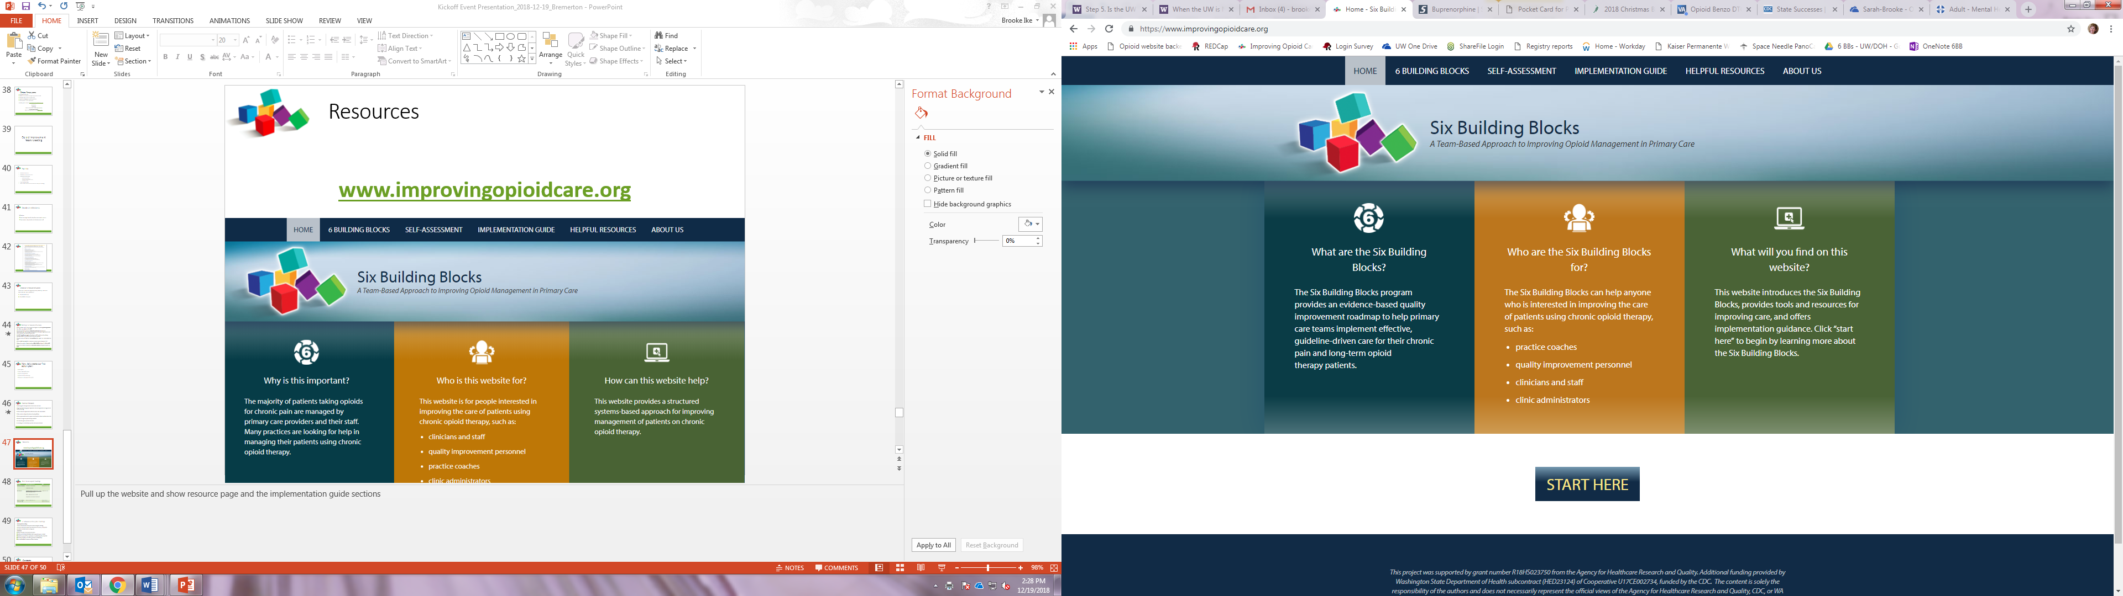
Resources
www.improvingopioidcare.org

Slide 35
Opioid Improvement
Team Meeting
Notes:
Bring up website on the computer

Slide 36
Agenda
Debrief on kickoff
Discuss using data to measure success
Review Six Building Blocks Milestones and identify milestones to achieve
Develop first action plan

Slide 37

Debrief on Kickoff
What did you learn during the Kickoff?
What did you hear were priorities for the work?
Was anything surprising?

Slide 38
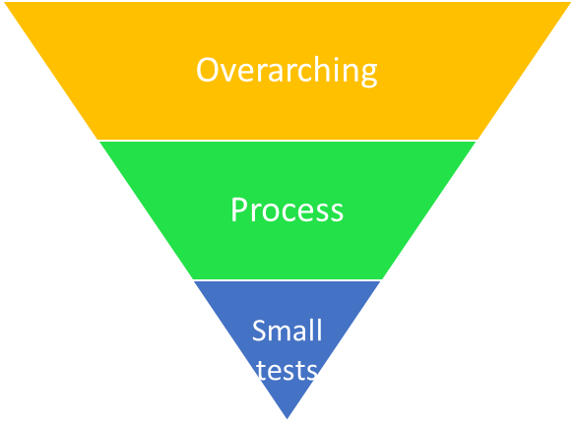
Using data to measure success
Types of measures
Reduce the number of patients with an MED of 50/90 or higher by XX% by DATE.
Identify and label all patients on long-term-opioid therapy with the same ICD-10 code by DATE.
Experience of front desk staff using an iPad to give patients annual pain visit forms over the course of one week.
Notes:
OVERARCHING: Why are you doing this work?
PROCESS: important process improvements that lead to the overarching aim
SMALL TESTS: fine-tuning approaches
As looking at data to assess your improvement work is a critical part of QI, the first meeting walks you through thinking through the 3 types of success measures and selecting measurable aims based on current capacity. Think of what is the overarching reason you are dong the work and set a feasible measurable aim to track your success. You might also want to set a process aim such as identifying and labeling patients by a set date. As you’re building tracking & monitoring approaches and workflows, small tests will also be very helpful to measure.
The important thing is to set a measure of success that is important to you and feasible and start there.
If you’re overwhelmed, don’t forget ‘back of the napkin’ options.
Just get into the habit of looking at data – qualitative or quantitative – to assess and guide next steps. As your capacity to measure grows, so can the kinds of data you are looking at.

Slide 39
Select initial measures
Select one or two measures of success to begin tracking, monitoring, and sharing with care teams that are:
Important to you
Feasible to measure
Motivating to clinicians and staff (encourages buy-in)
Notes:
It is useful to look at these measures by clinic, by provider, and by patient. You might also consider using a run chart to track your measures. Keep in mind that it takes effort and resources to produce these measures of success, so start small. You can add to it over time as your capacity to track grows.
Let’s take a look at the options

Slide 40
Potential measures of success
Overarching measures categories
High MED
Concurrent sedatives prescribed
Naloxone prescribed
Process measures categories
Identifying patients
Patient agreement reviewed and signed
Assessing function
Data to track care available
Process to identify care gaps in place
Workflows in use
MED recorded

Slide 41
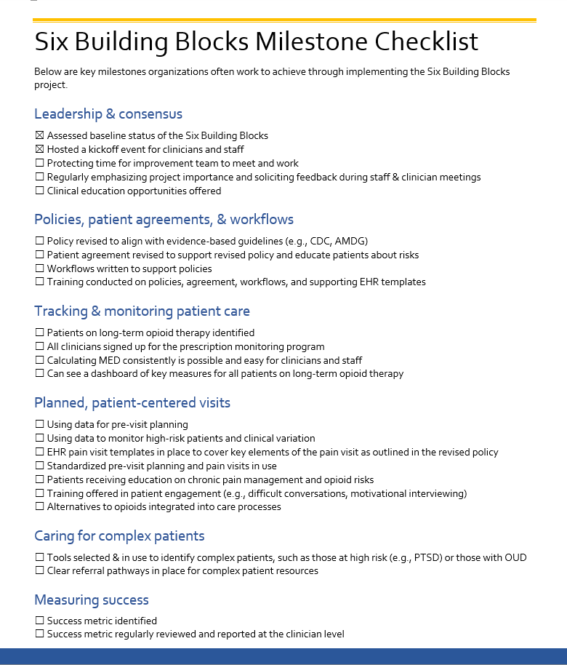
Identify milestones
  Do the milestones reflect what you want to achieve through this work?
  Are there milestones you want to add or remove from the list?
  What milestones are the biggest priorities for you?
  Which do you want to start working toward first?
Notes:
Let’s take a look at the Milestones.
I will include these in the Action Plans we create together so you can see how your work “paints the milestones green”.
We have resources to help you achieve each of these milestones.

Slide 42
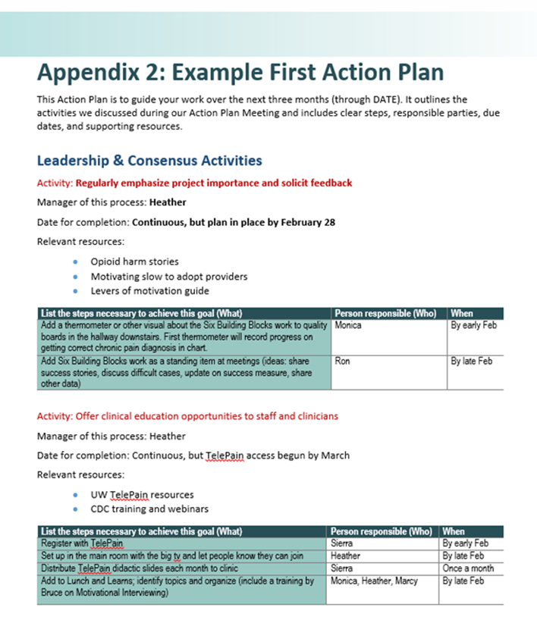
Now, let’s create your first action plan!
First goals?
Clear, attainable steps
Who is responsible
When it will be done by
Resources to support the work

Slide 43
Common first activities
Don’t forget: what, who when
Protecting time for improvement team to meet and work
Regularly emphasizing project importance and soliciting feedback during staff and clinician meetings
Clinical education opportunities offered to team, staff, and providers
Policy revised to align with evidence-based guidelines
Patients on long-term opioid therapy identified
All clinicians signed up for the WA PDMP

Slide 44
Next steps
I will write up and send Action Plan
I will summarize baseline assessment results and send
We will schedule the Shared Learning Calls
We will schedule the next Action Plan meeting
Reach out as you have question implementing your Action Plan!!!

Slide 45
Resources
www.improvingopioidcare.org
Notes:
Pull up the website and show resource page and the implementation guide sections

