Slide 1
Immigrants in Health Care Jobs
May 5, 2016
AAMC Health Workforce Research Conference
Chicago, IL
Davis G. Patterson, PhD
Bianca K. Frogner, PhD

Slide 2
Acknowledgment & Disclaimer
This study was supported by the National Center for Health Workforce Analysis (NCHWA), Health Resources and Services Administration (HRSA), U.S. Department of Health and Human Services (HHS) under cooperative agreement # U81HP27844. The information, conclusions and opinions expressed in this presentation are those of the authors and no endorsement by NCHWA, HRSA or HHS is intended or should be inferred.

Slide 3
Study context
World Health Organization’s Code of Practice on the International Recruitment of Health Personnel:
Monitor provider migration to detect imbalances.
U.S. imports healthcare providers:
How dependent are we on immigrants in health care jobs?

Slide 4
Design
Data: 3-year pooled, weighted sample of the American Community Survey, 2011-2013
Annual household survey, U.S. Census Bureau
Notes:
(Metro county has an urban core of at least 50,000 people)

Slide 5
Design
Data: 3-year pooled, weighted sample of the American Community Survey, 2011-2013
Annual household survey, U.S. Census Bureau
Selected persons ages 18-75 employed in healthcare
Occupations defined following the 2010 Standard Occupational Classification (SOC) System

Slide 6
Design
Data: 3-year pooled, weighted sample of the American Community Survey, 2011-2013
Annual household survey, U.S. Census Bureau
Selected persons ages 18-75 employed in healthcare
Occupations defined following the 2010 Standard Occupational Classification (SOC) System
Identified native U.S. citizens and immigrants—naturalized citizens and non-citizens

Slide 7
Design
Data: 3-year pooled, weighted sample of the American Community Survey, 2011-2013
Annual household survey, U.S. Census Bureau
Selected persons ages 18-75 employed in healthcare
Occupations defined following the 2010 Standard Occupational Classification (SOC) System
Identified native U.S. citizens and immigrants—naturalized citizens and non-citizens
Aggregate descriptive statistics – comparisons to the overall workforce (esp. differences)

Slide 8
Findings road map
How much of the health care workforce consists of immigrants?
Where from?
Demographics?
Where do they go?
Most common healthcare jobs?
Do their jobs match their education?

Slide 9
Immigrant employment in the U.S.
Immigrants are 18% of all employed workers,
16% of workers employed in health care

Slide 10
Immigrant employment in the U.S.
Immigrants are 18% of all employed workers,
16% of workers employed in health care
Proportions employed in health care by immigrant/citizenship status:
Native born: 10.8%
Naturalized: 14.4%
Noncitizen: 6.5%

Slide 11
Immigrant unemployment
Unemployment rate among health care workers (2011-13 pooled data):
Native born: 4.7%
Naturalized: 3.4%
Noncitizen: 6.0%
(compared to 9.0% for total labor force)

Slide 12
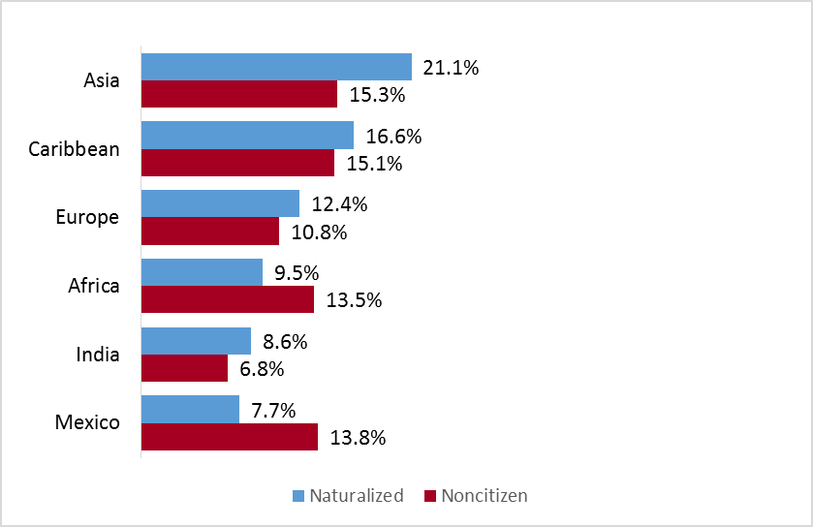
Where do immigrants in healthcare come from? (top regions/countries)
Notes:
Top birth countries were Philippines, Mexico, India. Those 3 countries contribute about a third of all immigrants in health care jobs. *Note that Mexico is top source of nonmetro healthcare non-citizens (35.8%) [for all occupations, Mexico is 40.6% of non-citizens].
US: Note that Mexico is the top sending country to the US by far compared to others for all immigrants, but NOT in healthcare nationally.
Mexico DOES contribute the most non-citizen immigrants in rural areas. Nationally, Caribbean immigrants are overrepresented in metro healthcare jobs, and Europeans/Russians are overrepresented in rural.
Scanning through, you can see that each state tends to have a somewhat unique immigrant pattern.
Notice that in the rural Northwest Asians tend to be naturalized citizens while non-citizens tend to be Canadians, Mexicans, and Europeans/Russians.
[Places that are not represented: Central America, Middle East]

Slide 13
Where do immigrants in healthcare come from? (top regions/countries)
Top three countries:
1. Philippines
2. Mexico
3. India
Notes:
Top birth countries were Philippines, Mexico, India. Those 3 countries contribute about a third of all immigrants in health care jobs. *Note that Mexico is top source of nonmetro healthcare non-citizens (35.8%) [for all occupations, Mexico is 40.6% of non-citizens].
US: Note that Mexico is the top sending country to the US by far compared to others for all immigrants, but NOT in healthcare nationally.
Mexico DOES contribute the most non-citizen immigrants in rural areas. Nationally, Caribbean immigrants are overrepresented in metro healthcare jobs, and Europeans/Russians are overrepresented in rural.
Scanning through, you can see that each state tends to have a somewhat unique immigrant pattern.
Notice that in the rural Northwest Asians tend to be naturalized citizens while non-citizens tend to be Canadians, Mexicans, and Europeans/Russians.
[Places that are not represented: Central America, Middle East]

Slide 14
Where do immigrants in healthcare come from? (top regions/countries)
Top three countries:
1. Philippines
2. Mexico
3. India
Notes:
Top birth countries were Philippines, Mexico, India. Those 3 countries contribute about a third of all immigrants in health care jobs. *Note that Mexico is top source of nonmetro healthcare non-citizens (35.8%) [for all occupations, Mexico is 40.6% of non-citizens].
US: Note that Mexico is the top sending country to the US by far compared to others for all immigrants, but NOT in healthcare nationally.
Mexico DOES contribute the most non-citizen immigrants in rural areas. Nationally, Caribbean immigrants are overrepresented in metro healthcare jobs, and Europeans/Russians are overrepresented in rural.
Scanning through, you can see that each state tends to have a somewhat unique immigrant pattern.
Notice that in the rural Northwest Asians tend to be naturalized citizens while non-citizens tend to be Canadians, Mexicans, and Europeans/Russians.
[Places that are not represented: Central America, Middle East]

Slide 15
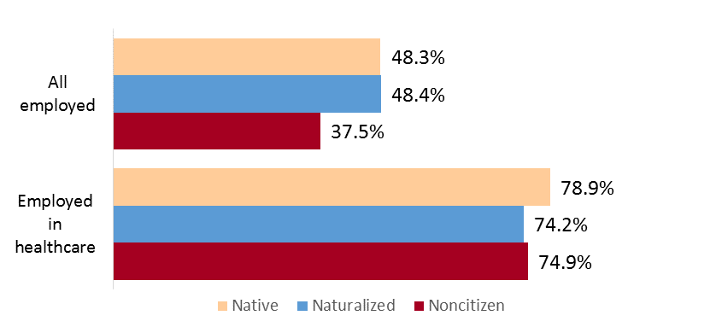
How do the demographics of immigrant healthcare workers compare?
Women

Slide 16
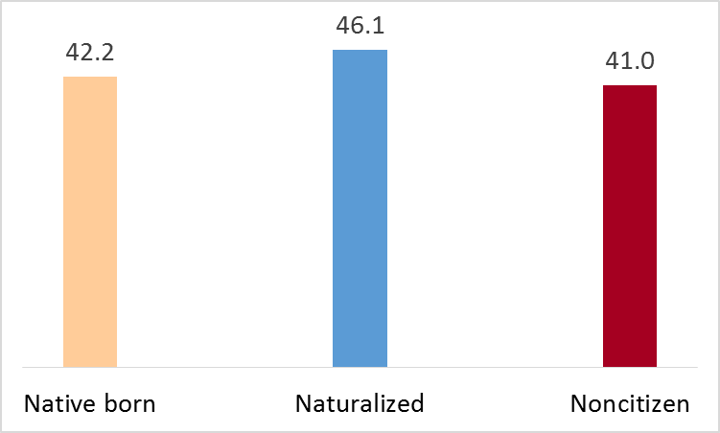
Demographics
Mean age (healthcare workers)
Notes:
As expected, naturalized citizens, who are older, have been in the U.S. longer, about 10 years longer on average. (The reverse pattern in Wyoming is probably random variation as a result of small numbers.)
[Non-metro immigrants generally have been in the US longer than metro immigrants nationally and in the Northwest.]

Slide 17
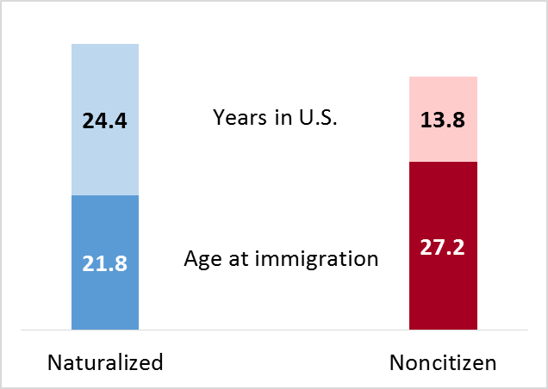
Migration and life course (heathcare workers)
Notes:
Similar to distribution for all occupations
[Non-metro immigrants generally have been in the US longer than metro immigrants nationally.]

Slide 18
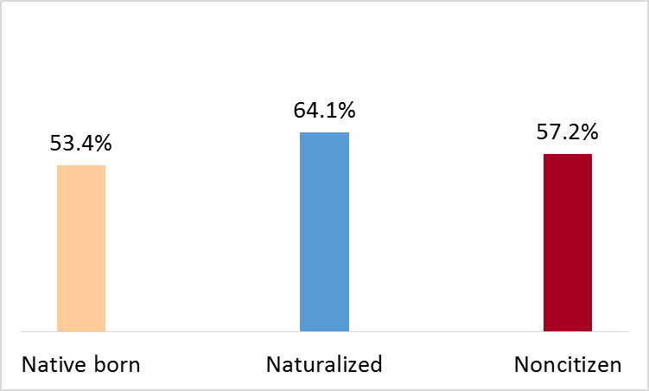
Demographics
Married (healthcare workers)
Notes:
As expected, naturalized citizens, who are older, have been in the U.S. longer, about 10 years longer on average.
[Non-metro immigrants generally have been in the US longer than metro immigrants nationally and in the Northwest.]

Slide 19
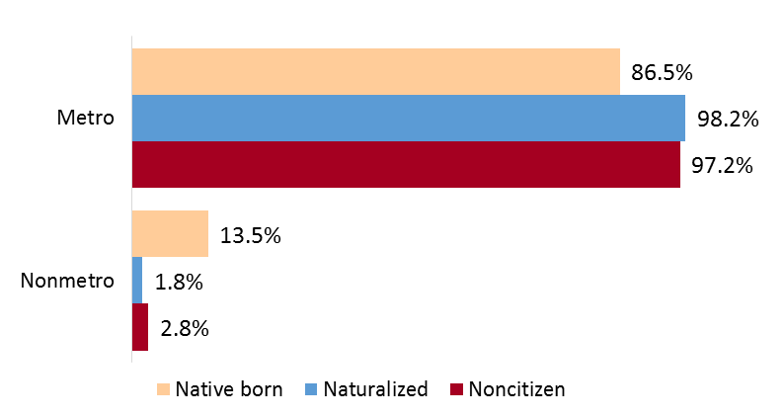
Demographics
Metro/nonmetro residence (healthcare workers)
Notes:
[Non-metro immigrants generally have been in the US longer than metro immigrants nationally and in the Northwest.]

Slide 20
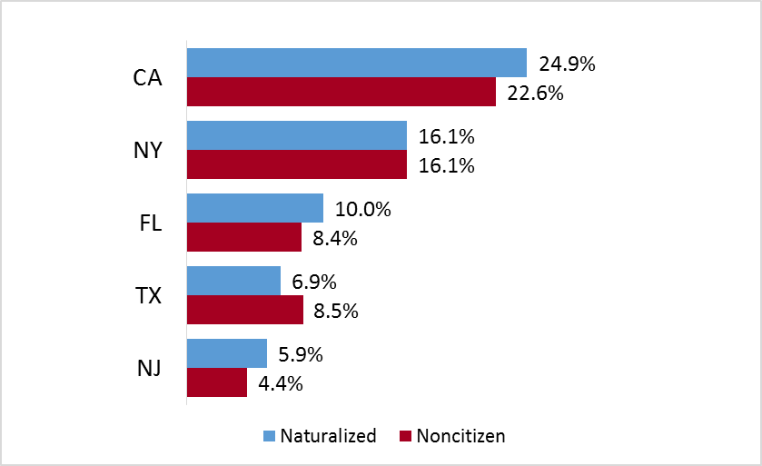
Demographics
Top states of residence:
% of all immigrants in healthcare jobs, by state
Notes:
***These states, with Nevada instead of Texas, have the highest shares of their total healthcare workforce made up of immigrants (denominator = all state healthcare workers: range 23%-35%)

Slide 21
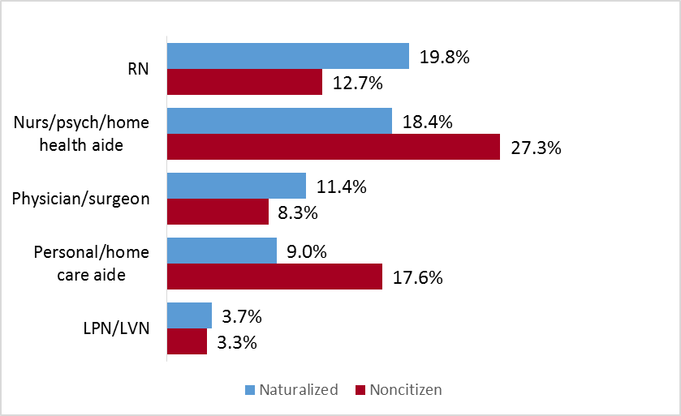
Most common healthcare jobs – top immigrant occupations

Slide 22
Most common healthcare jobs – top immigrant occupations

Slide 23
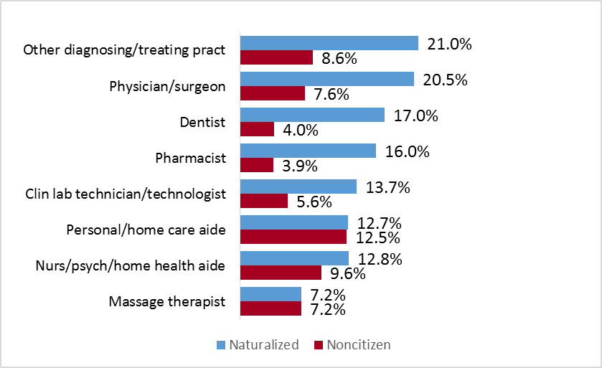
Most common healthcare jobs – greatest share of immigrants employed

Slide 24
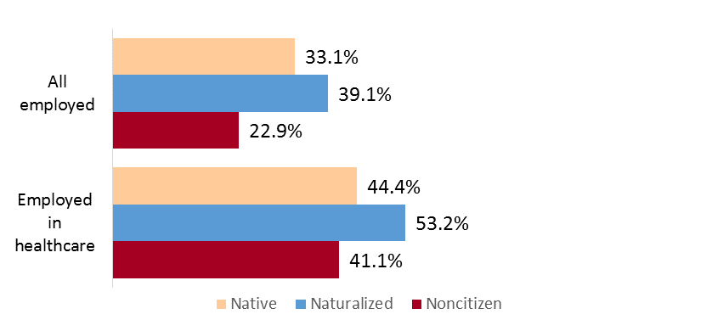
Education
% with bachelor’s degree or higher
Notes:
In non-metro areas in the US overall, U.S. citizens have the least education of the three groups.
Naturalized citizens tend to have the most education.
[At the national level in metro areas (not shown), U.S. citizens and naturalized citizens have more education than non-citizens. Metro generally more educated than non-metro for citizens, but mixed among naturalized citizens and non-citizens—goes both ways depending state.]

Slide 25
Education
% with bachelor’s degree or higher
Notes:
In non-metro areas in the US overall, U.S. citizens have the least education of the three groups.
Naturalized citizens tend to have the most education.
[At the national level in metro areas (not shown), U.S. citizens and naturalized citizens have more education than non-citizens. Metro generally more educated than non-metro for citizens, but mixed among naturalized citizens and non-citizens—goes both ways depending state.]

Slide 26
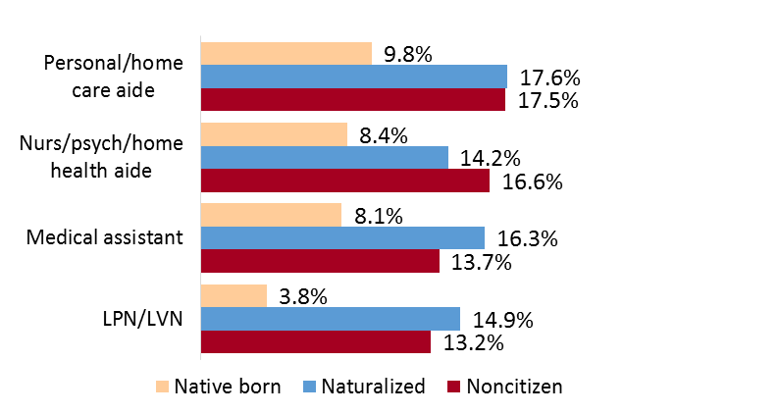
How well do jobs match education?
% with bachelor’s degree or higher
Notes:
About twice as many immigrants appear to be greatly overqualified for lower skilled health care jobs than native-born citizens.

Slide 27
How well do jobs match education?
Immigrants look ~2-3X as likely as native-born to be greatly overqualified for less skilled healthcare jobs.
% with bachelor’s degree or higher
Notes:
About twice as many immigrants appear to be greatly overqualified for lower skilled health care jobs than native-born citizens.

Slide 28
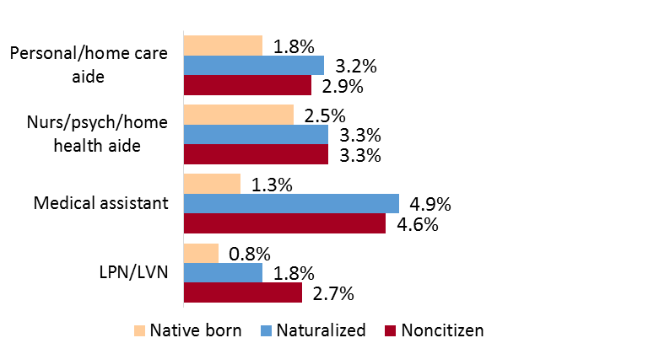
How well do jobs match education?
% with master’s degree or higher
Notes:
About twice as many immigrants appear to be greatly overqualified for lower skilled health care jobs than native-born citizens.

Slide 29
How well do their jobs match their education?
% with master’s degree or higher
Notes:
About twice as many immigrants appear to be greatly overqualified for lower skilled health care jobs than native-born citizens.

Slide 30
Key findings
Naturalized citizens’ top healthcare jobs are a mix of more and less skilled occupations—more like the native-born.
Noncitizens are more concentrated in less skilled jobs (e.g., aides). Slightly younger, less educated, more unemployed—appear at more long-term financial risk.
Some immigrants (both naturalized and noncitizens) appear to be overqualified educationally for the lower skilled jobs they occupy.
Notes:
Noncitizens appear to be younger and more vulnerable than naturalized citizens. Noncitizens tend to be in lower skilled jobs than those they may have otherwise been qualified for in their countries of origin. Although these immigrants may have come to the U.S. for upward mobility, the outlook for these entry level opportunities may put them at long-term financial risk.

Slide 31
Implications
Can the U.S. find ways to grow more of its own healthcare workforce rather than import?
Are we making the most of our human resources in health care?
Perhaps non-citizens will continue to acquire skills/credentials, but with average age 41 and 14 years in the U.S.—how much more will they advance? Opportunities for upward mobility?
Some immigrants appear overqualified for jobs they fill. What are their specific degrees/credentials? Are there mismatches? Solutions to make better use of immigrant skills/credentials?

Slide 32
Contact
Davis Patterson, PhD
University of Washington Center for Health Workforce Studies
davisp@uw.edu
206.543.1892
http://depts.washington.edu/uwchws/
http://depts.washington.edu/uwrhrc/

